Slide 1

Programming Robot Car Elegoo robot

Slide 2
Building and Programming robots in TINKERCAD
This week you be returning to TinkerCad Circuits to start programming the self-driving car. This workshop aims to revisit the text programming done previously and continue to develop your text programming skills.
Please complete the bronze requirements before starting the silver,
and complete the silver before starting the gold.

Slide 3
BRONZE Challenge: Building your robot circuit
At the challenge day, you’ll be using the Elegoo Robot. The components listed here can be used to build an equivalent robot in TinkerCAD allowing code to be transferred across on the challenge day.
You can either match the exact component list or adapt to match your robot design. Note, the Elegoo is a 4-wheel robot but the motor controls are paired up so can be simulated with only 2 motors.
Important: To transfer your code to the real robot for the challenge day, you will need to make sure components are connected to the correct pins. Components and pins are specified on the next slide.
Components
Arduino Uno
9V Battery
IR sensor
IR remote
H-Bridge motor driver
2x Hobby Gear Motor
3x PIR sensor
Micro servo
Ultrasonic Distance Sensor (4-pin)

Slide 4
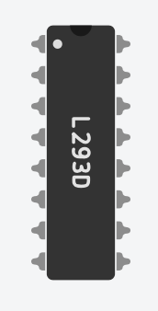
BRONZE Challenge: Elegoo Robot Motors
The robot gear motors are connected via a motor driver
H-Bridge motor driver
H-Bridge pin | to
Enable 1&2 | Arduino ~5
Input 1 | Arduino 7
Output 1 | Motor 1 positive
Ground | 9V battery negative
Ground
Output 2 | Motor 1 negative
Input 2 | Arduino 8
Power 2 | 9V battery positive
H-Bridge pin | to
Power 1 | 9V battery positive
Input 4 | Arduino ~11
Output 4 | Motor 2 positive
Ground | 9V battery negative
Ground
Output 3 | Motor 2 negative
Input 3 | Arduino ~9
Enable 3&4 | Arduino ~6

Slide 5
BRONZE Challenge: Other components
The power pins on components can be connected to the same pins on the Arduino, like a breadboard
from | to
PIR 1 signal | Arduino 2
PIR 2 signal | Arduino 4
PIR 3 signal | Arduino ~10
Servo signal | Arduino ~3
Ultrasonic Trig | Arduino A5
Ultrasonic Echo | Arduino A4
IR sensor out | Arduino 12
Power | to
* power | Arduino 5V
* ground | Arduino GND
9V battery positive | Arduino Vin
9V battery negative | Arduino GND

Slide 6
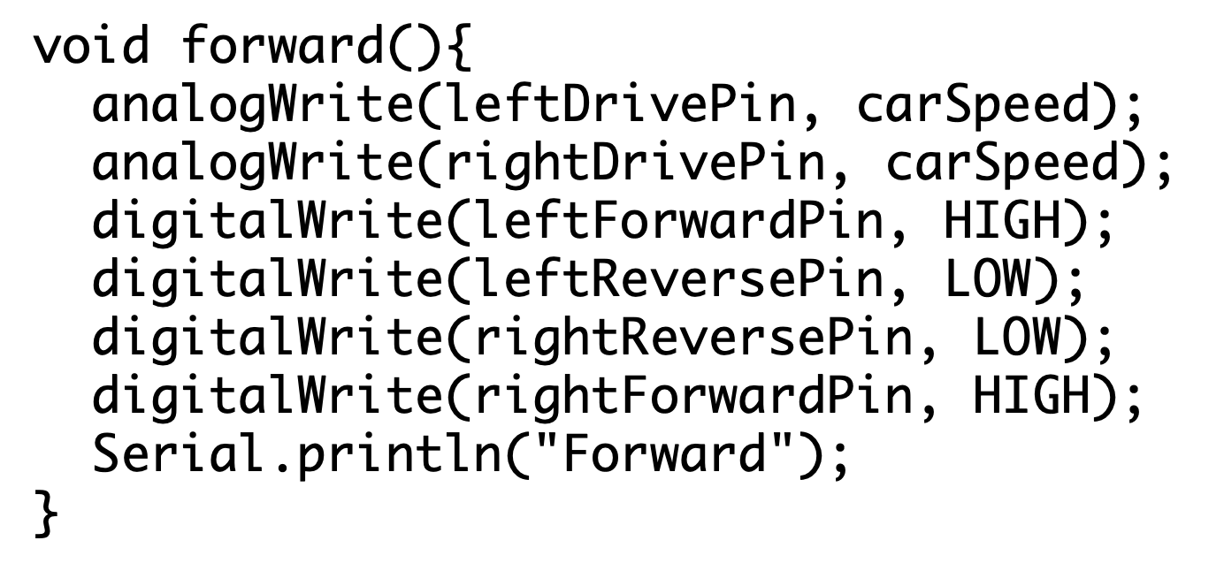
SILVER Challenge:
Aims:
Write functions to drive the robot forward, left, right, backwards and stop
Remember to setup the relevant pins as outputs
In the main loop, set the speed for your car to drive in different directions
Can you get the car to slowly accelerate and decelerate (slow down) to a target speed?
  Hint: a for loop will be useful to do this
  for(int i=0; i<target; i++)
Notes:
In void setup(), use pinMode(pin, OUTPUT); to specify a pin for output
The H-Bridge for the Elegoo allows us to specify how fast the motor turns, rather than just on/off. This is done using analogWrite to the drive pin, with a value between 0-255
To recap on programming the robot, watch the video for this week
Example movement function:

Slide 7
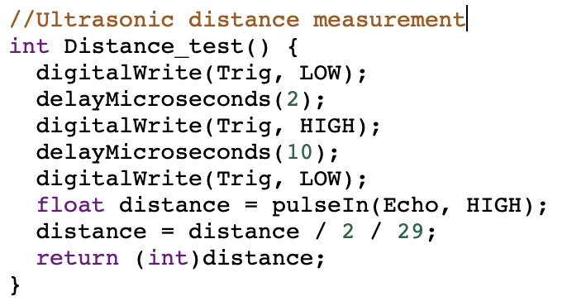
GOLD Challenge:
Aims:
Write a function to obtain a distance from the ultrasonic sensor. The function should return a number (distance in cm)
  Remember to set the trigger pin as output and echo pin as input
Add the servo library
  #include <Servo.h> //servo library
  Servo myservo;
In the setup function initialise the servo:
  myservo.attach(servoPin);
Notes:
Remember to watch the video to guide you through this task.

Slide 8
GOLD Challenge:
Aims:
In the main loop, move the servo ready to the take three ultrasonic readings around the robot
e.g. myservo.write(90);
Move the servo to these three positions (remembering to allow time for the servo to move before taking the reading)
  0 degrees – left distance
  90 degrees – centre distance
  180 degrees – right distance
Call the function to get ultrasonic readings after each servo movement and store the readings in three variables, e.g.
int leftDistance = getDistance();
Notes:
To move the servo you can use the function servo.write(angle);
You can create a new variable called and assign it to readUltrasonic, e.g.
int leftDistance = readUltrasonic();
Remember to watch the video to recap how do do this task.

Slide 9
GOLD Challenge:
Aims:
Using a set of if-statements, identify which direction has the ‘shortest’ distance and which has the longest. Print the answers to the serial monitor
  Remember to use Serial.begin(9600); in the setup function to be able to print to the Serial monitor
Notes:
if statements create the ‘logic’ of your program. E.g.
if (leftDistance < centreDistance) {
//do something
}
If statements can be nested inside each other
if-else(condition) can be used to add addition logic to if-statements
Use the serial monitor to help solve problems by printing out what part of the code is running e.g. Serial.println(“driving forward”); or Serial.println(“found obstacle”);

Slide 10
Extension Challenge:
What else can you add to this program?
Can you implement a function to take readings from the PIR sensors and report which sensors detect the line?

Slide 11
Thank You

