Slide 1
Vehicle 3D design

Slide 2
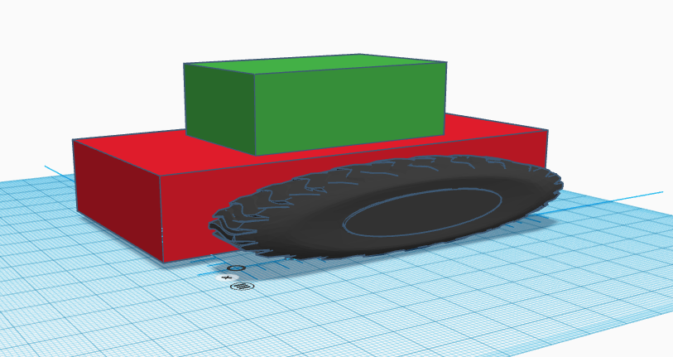
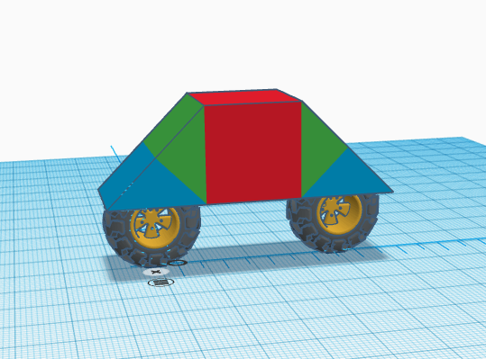
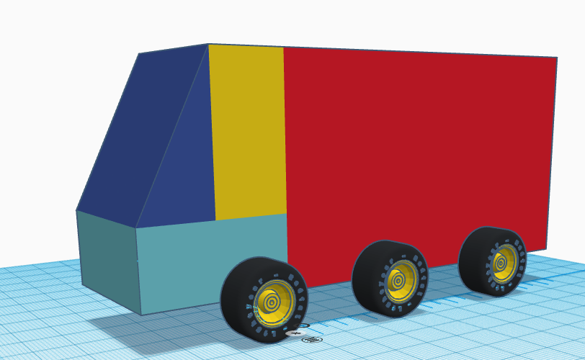
BRONZE Challenge:
Produce your basic vehicle shape. As a reminder here are some examples:

Slide 3
Add an ultrasonic sensor and an Arduino from the electronics shapes menu.
1. Attach your ultrasonic sensor where you think is best for your vehicle.
2. Make sure your design is large enough to hold the Arduino.
SILVER Challenge:

Slide 4
GOLD Challenge:
This is your chance to add extra details to your vehicle.
Add curves and/or slopes to make it less blocky.
Use the ‘scribble’ shape in the basic shapes menu to create a logo to go on your vehicle.
Consider where the wheels connect and how to make sure they have enough space to turn.
Remember you can create and save your own shapes

Slide 5
Extension Challenge:
Create an environment for your design. Examples include; a roadway, the countryside, in a city, floating in space, car showroom.

Slide 6
What next?
Next week we will look at how to make your designs so they are hollow, for housing all your components.
You shall also have a chance to finish your design if you haven’t managed to this week.

