Slide 1
Introduction to 3D design

Slide 2
BRONZE Challenge:
Getting used to the software by producing a model of a pencil.
Step-by-step instructions are available in our guide to making a pencil model.

Slide 3
We’ve put together a series of shapes to re-create in Tinkercad:
See our 3D Shapes Challenge webpage for more details.
SILVER Challenge:

Slide 4
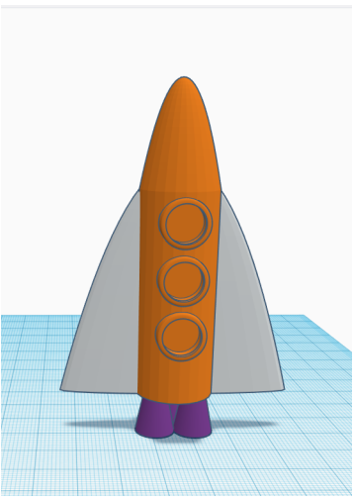
GOLD Challenge:
Can you make a more complex model of a space rocket?
You can create your own design or use our rocket construction guide to recreate the one shown here.

Slide 5
Extension Challenge:
Using only shapes available in the Basic Shapes menu on Tinkercad, try to re-create this robot:

Slide 6
What next?
Check out the ‘scribble’ shape in the Basic Shapes menu.
Explore the other shape menus to see what is available for your own vehicle design.
Start thinking about what your vehicle will look like. How many wheels/tracks/legs will it have? Which is the main sensor it will need to avoid obstacles? Where will it be on your vehicle? Perhaps start drawing some ideas on paper and then consider how to re-create them using the shapes available in Tinkercad.

