Slide 1
Introduction to 3D design

Slide 2
BRONZE Challenge:
We’ve put together a series of shapes to re-create in Tinkercad:
See our 3D Shapes Challenge webpage for more details.

Slide 3
In the electronic components list of shapes, select the Arduino Uno.
1. Design a case for the Arduino to fit into that will allow access to the pins, as well as the power and download cable sockets.
2. We now need to think about how this case would be made. This means separating it into 2 pieces that can be screwed together around an Arduino. Remember to include the screw holes for this and for mounting.
SILVER Challenge:

Slide 4
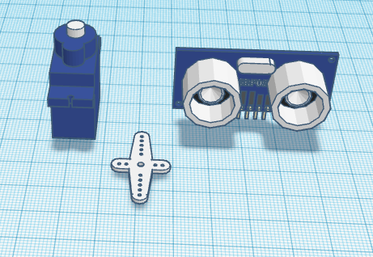
GOLD Challenge:
Using the components shown, create a mount for an ultra-sound sensor on a servo. You will need to match up screw holes and make sure the design doesn’t overlap with any of the component parts. Remember to leave space for wiring.

Slide 5
What next?
For returning members: Think about your designs from last year and how they were built around the components.
Over the next couple of weeks we’ll be developing printer friendly designs of robots. This will involve designing panels and casings for the necessary components which are 3D printer friendly and fit the necessary components.

