Slide 1

Self Driving Robot
Programming a robot car to drive autonomously

Slide 2
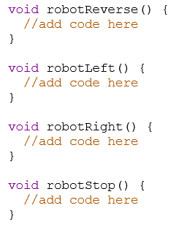

Joining the Classroom
Go to www.tinkercad.com/joinclass
Enter class code: H5JTYVF9RZ9U
Enter your nickname as provided by us

Slide 3
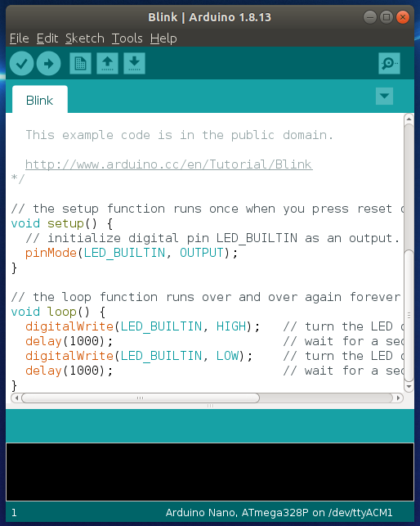

Connecting and Downloading to Arduino:
Step 1: Copy and paste your text code into Arduino IDE.
Step 2: Click on the tick in the top left to ‘compile’ code.
Step 3: Plug your Elegoo into the computer.
Step 4: Click on the circle with a → arrow to transfer.
Note: You can also use the magnifying glass icon (top right)
to see the serial-monitor for your connected Arduino.
IMPORTANT: Disconnect your robot and put it on the floor before turning it on

Slide 4
BRONZE Challenge:
Autonomous following a line:
Using the line following sensors get your robot to follow line 1
What adjustments might need to be made for lines 2 and 3?
What happens if you speed up the robot?
How far can you get along each of the lines?

Slide 5
SILVER Challenge:
Obstacle avoidance:
Using the ultrasonic sensor and servo have the robot driving around avoiding obstacles
Drive forward until an obstacle is detected
When an obstacle is detected the robot should stop, then decide which direction to turn
Turn 90 degrees and continue

Slide 6
GOLD Challenge:
Maze Navigation
Using the ultrasonic sensor and servo, can you get your robot to Safely navigate around the maze without hitting any of the walls?

