Slide 1
Python programming 4 Challenges

Slide 2
We are using 2 platforms for this:
code club https://projects.raspberrypi.org/en/pathways/python-intro
And trinket
https://trinket.io/
To set yourself up, open both of these websites in separate browser tabs.
Create an account for yourself in each, and be sure to remember the password.

Slide 3
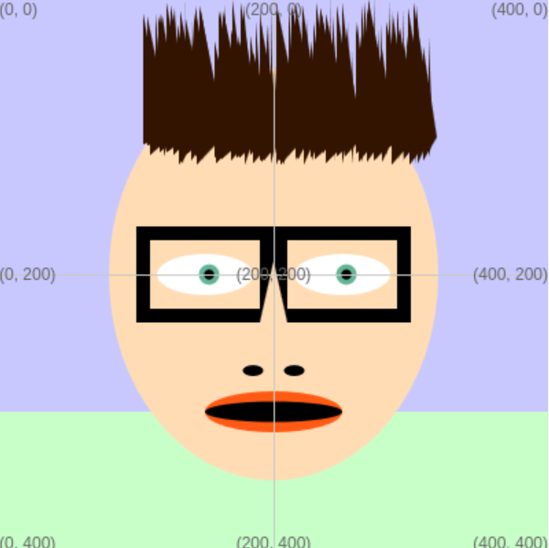
If you haven’t done week 1, first have a go at that.
Then have a go at week 2 (target practice)
Then have a go at week 3 (rocket launch)
And finally… move on to this week’s: make a face!

Slide 4
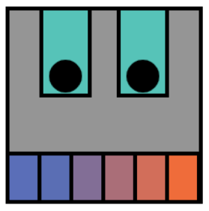
CHALLENGE ONE
Getting started
BRONZE:
Decide what shape of face you want and draw the base. It could be an ellipse, or a rectangle. You might choose to draw a robot or a human or something completely different!
Once you’ve done this, share with a robot club helper who can confirm you have Bronze before continuing.

Slide 5
CHALLENGE ONE
Eye See You
SILVER :
Decide what kind of eye you want and draw one.
Once you have an eye you like, turn it into a function!
That way you can draw two eyes easily.
Share your project again

Slide 6
CHALLENGE ONE
Mouth
GOLD :
Draw yourself a mouth
Well done, you’ve done the basics… now to take it further!

Slide 7
CHALLENGE TWO
Going further: pick an extra activity or two
Can you give it ears?
A nose?
Glasses?
Hair?
Can you animate your face?
...

