Slide 1
Python programming 1

Slide 2
We are using 2 platforms for this:
code club https://projects.raspberrypi.org/en/pathways/python-intro
And trinket
https://trinket.io/
To set yourself up, open both of these websites in separate browser tabs.
Create an account for yourself in each, and be sure to remember the password.

Slide 3
Code club https://projects.raspberrypi.org/en/pathways/python-intro
has a series of exercises which lead you through python programming from the beginning. These exercises come with badges and quizzes allowing you to test your knowledge as you learn.

Slide 4
Trinket https://trinket.io/
is a website that lets you edit python programs and run them in the same window. It also lets you save your work, and share it with other people, which will help if you get stuck (you can share it with robot club helpers).

Slide 5
CHALLENGE ONE
Getting started
BRONZE:
Start the hello world project (which uses lots of emoji) 🌍 🐍
https://projects.raspberrypi.org/en/projects/hello-world/
When you have your project showing share it with one of the robot club helpers to check it works (and you can share things).

Slide 6
CHALLENGE ONE
Numbers, dates and randomness
SILVER :
Complete “Sums and Dates”, and then “Roll a Dice”.
Share your project again

Slide 7
CHALLENGE ONE
Questions and answers
GOLD :
Complete “Sentence starter”, and then do the quiz.
Well done, you’ve done the basics… now to take it further!

Slide 8
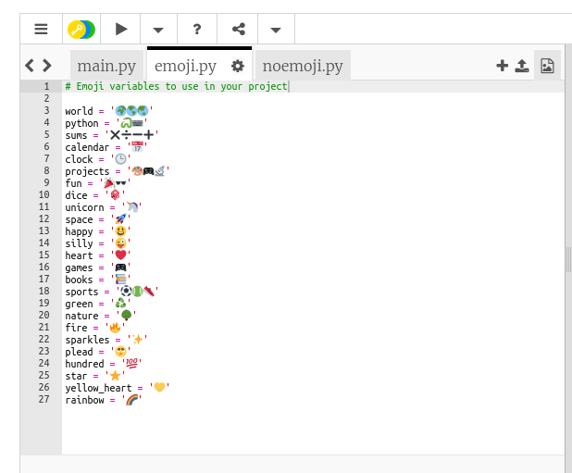
CHALLENGE TWO
Going further
Add more emoji to emoji.py
Write some code which uses your new emoji
Look at noemoji.py – can you work out how to incorporate that into your code?
Can you make your code compliment people?
How about a random compliment generator with emoji?

