Slide 1
Radio Communication

Slide 2
Games
This week you be creating two different programs.
The first is to test your understanding of the radio communications content.
The second is introducing a new type of variable.

Slide 3
Rock, Paper, Scissors

Slide 4
BRONZE Challenge:
Create a start-up routine for your program
When shaken have the Micro:Bit generate a random number between 1 and 3
Save this number in a variable
The variable should then trigger an image for either rock, paper or scissors.
(1 = rock, 2 = paper, 3 = scissors)

Slide 5
SILVER Challenge:
Set a radio group for your Micro:Bit in the on-start.
Send the variable value after shaking via radio
Set your program to only send this value if it is greater than zero.
Have the program receive the value, store it in a new variable, and show the matching image if button B is pressed.

Slide 6
GOLD Challenge:
Can you make the Micro:Bits show which one won and which one lost?
You will need to compare the variables for shaking to the one received.
Create a winning and losing screen
Remember: Rock beats scissors, scissors beats paper, and paper beats rock.
Decide what should happen if there’s a draw.

Slide 7
STOP!
If you are doing these challenges as part of our Wednesday Zoom session, let a member of staff know that you have completed the work so far.
Do not continue until we confirm that we have saved a copy of your program. Once confirmed, delete everything and start again with the next set of exercises.

Slide 8
Magic-8 Ball

Slide 9
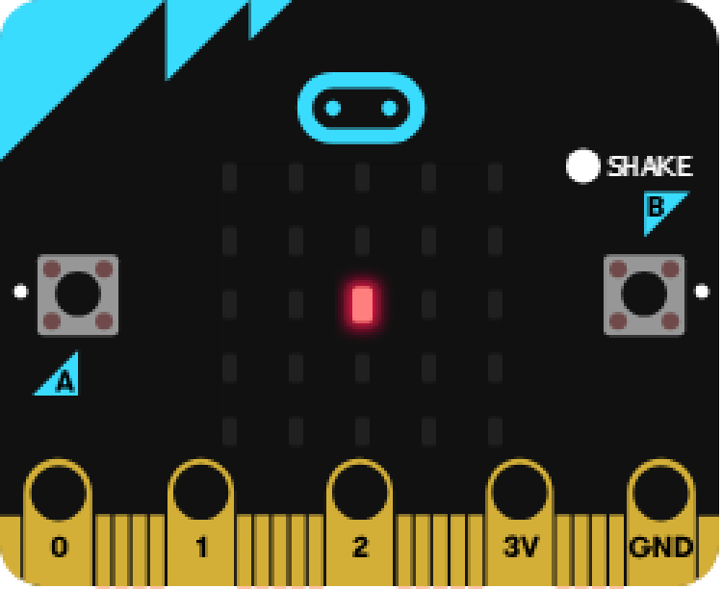
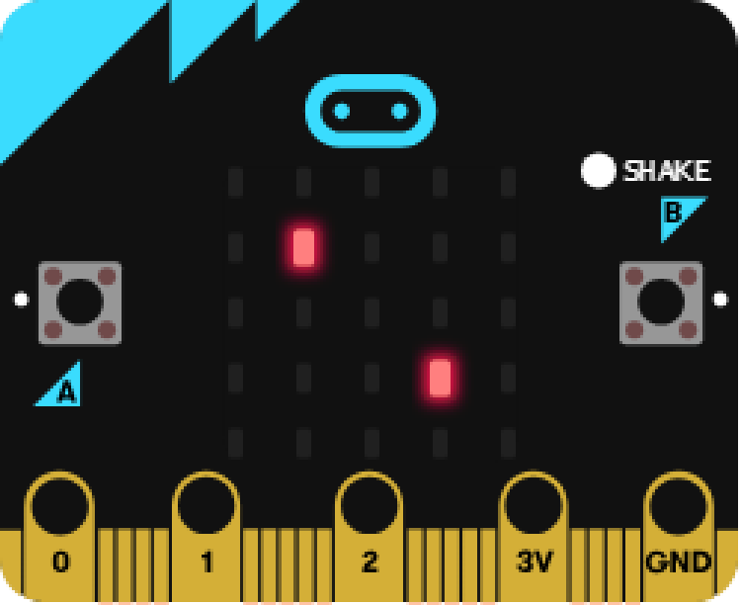
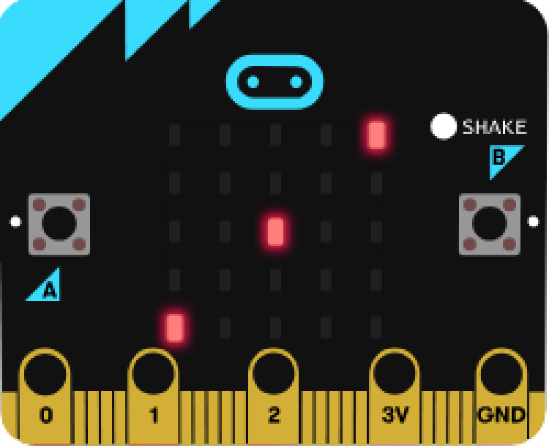
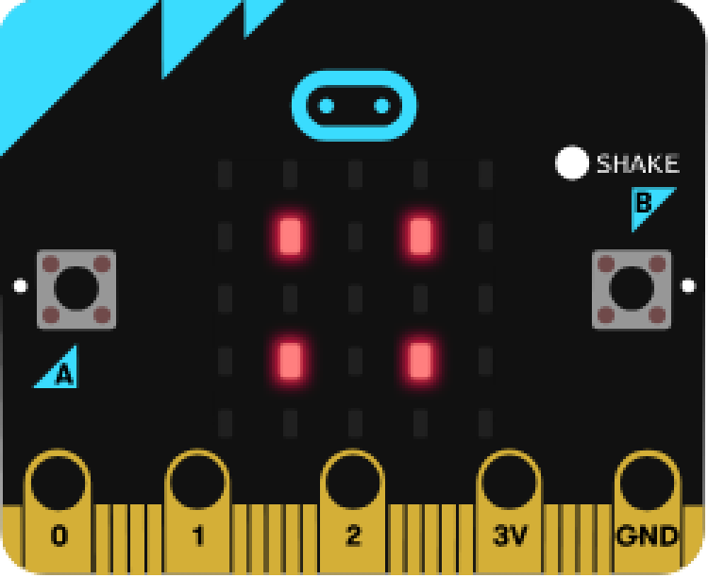
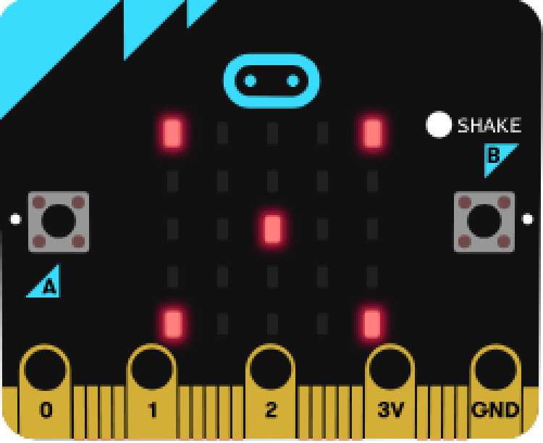
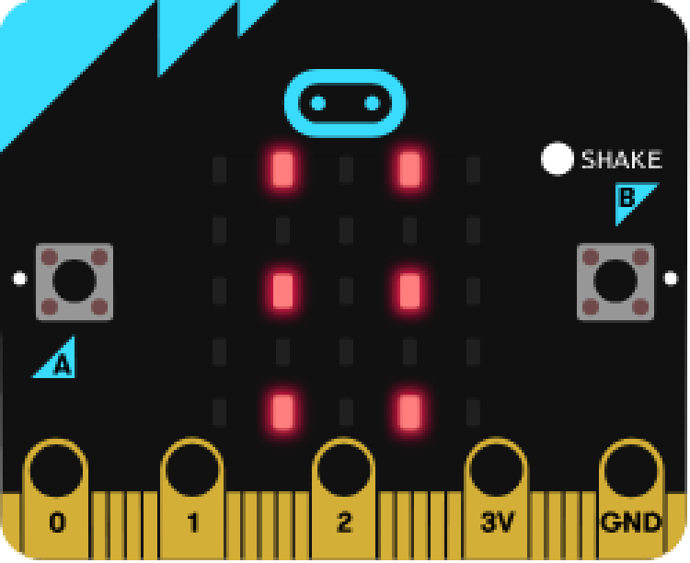
BRONZE Challenge:
Create a basic dice rolling program on your Micro:Bit. This should show a random number between 1 and 6 on the screen when shaken.
Don’t forget to create a start-up routine.
Instead of showing a number, have the screen show images depending on the value rolled. For example:

Slide 10
SILVER Challenge:
A Magic-8 Ball is like a dice, put instead of numbers it produces answers when shaken.
Instead of showing numbers in your program, have the Micro:Bit display the answers yes, no, maybe, go for it, good idea, bad idea, don't know, definitely, absolutely not, and no idea.
Note: There are now 10 options.

Slide 11
New Block:
There is a different way we could have approached this program. We could have used something called an array. Array blocks can be found in the Advanced menu.
An array is a special kind of variable. Instead of holding only a single piece of information like the variables we've used, it can hold a list of values/strings.
You can then call a value from the array by its location in the list. As with most coding, the numbering of list items starts at zero.

Slide 12
Example:
Let's say we wanted to write a program that randomly selected a string from a list of apple, orange, and banana when we press button A.
As with any variable, we need to set the array in the 'on start' section:
We can add or take away items to the array using the plus and minus buttons on the block.

Slide 13
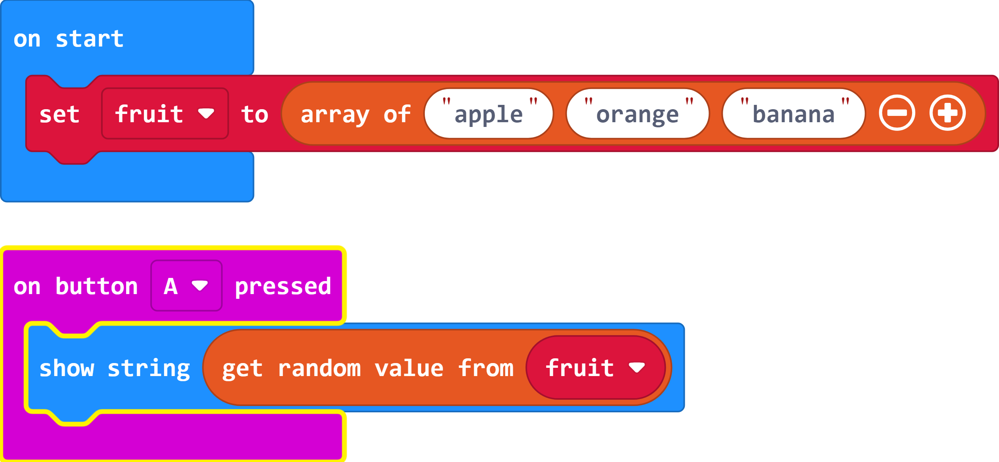
Example:
To have the screen show a random item from the array we can use the 'show string' combined with a 'get random value from' array block.
We now have a complete program that randomly selects an item from the list and displays it on the screen when we press button A.

Slide 14
Important:
Arrays cannot be used to replace all if and else if statements. With Makecode, they can only be used for lists of strings.
For example, you could not use this for the dice program with different images for each value.

Slide 15
GOLD Challenge:
Change your Magic-8 Ball program to use an array for all possible answers and randomly select from it when shaken.
Add some of your own answers to the program.

Slide 16
Extension Challenge:
Now that you've discovered random generators using arrays, there are number of different fun things you can create. Here are some ideas:
Creative writing program - have a series of arrays to help put together a storyline idea. For example, you could have random location/genre/character/sidekick generators.
Shopping mayhem app - put your shopping list into an array and then use the random generator to decide what order to shop in. You may want to do some research on how to remove items from an array after they've come up.

Slide 17
Thank You

