Slide 1
Using Breadboards

Slide 2
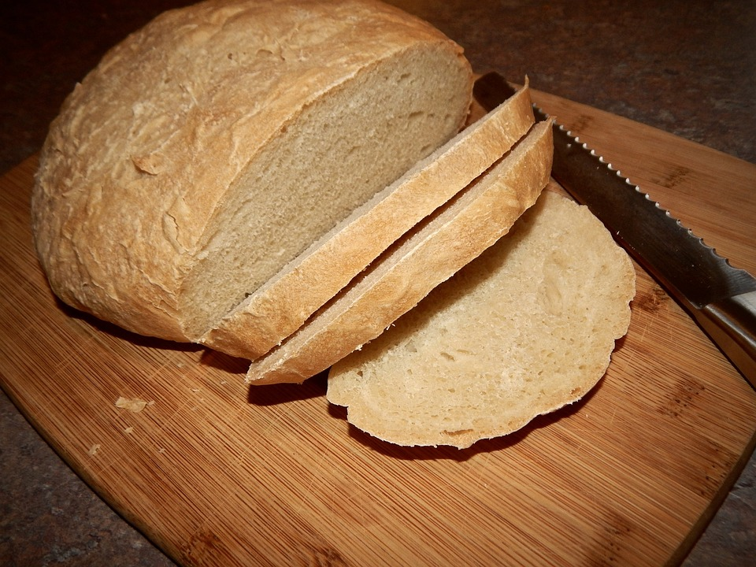
What is Breadboard?

Slide 3
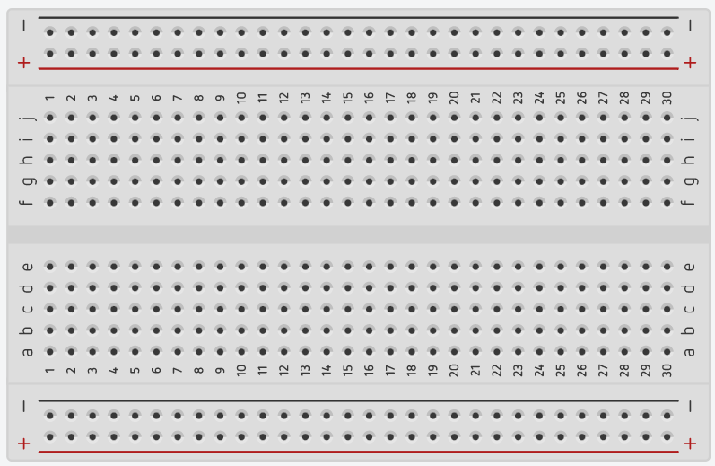
What is Breadboard – In Electronics?

Slide 4
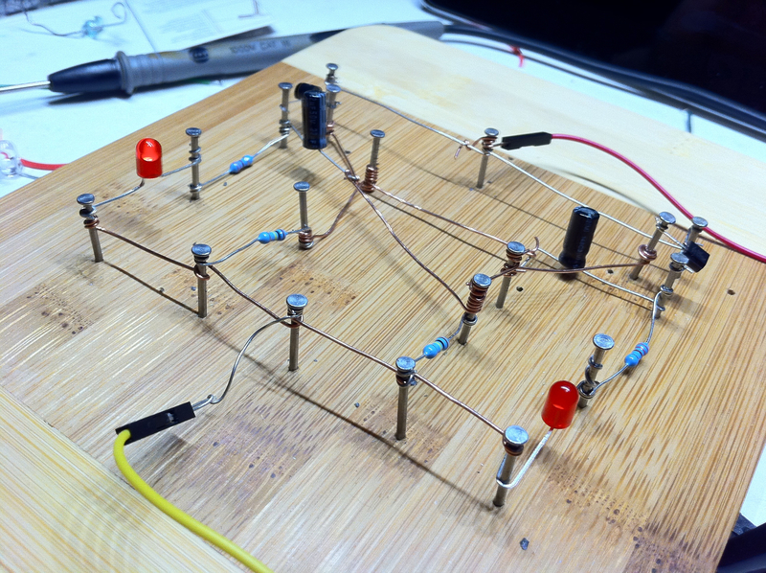
Why is it called a Breadboard?

Slide 5
How a Breadboard Works:

Slide 6
How a Breadboard Works:

Slide 7
Why use a Breadboard?
A breadboard is a tidier way to use lots of components in a circuit. Main reason is so we only have one connection with the GND pin on micro-controllers like the Micro:Bit.

Slide 8
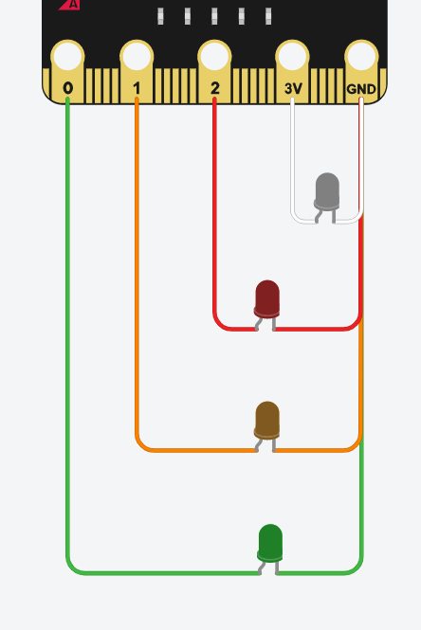
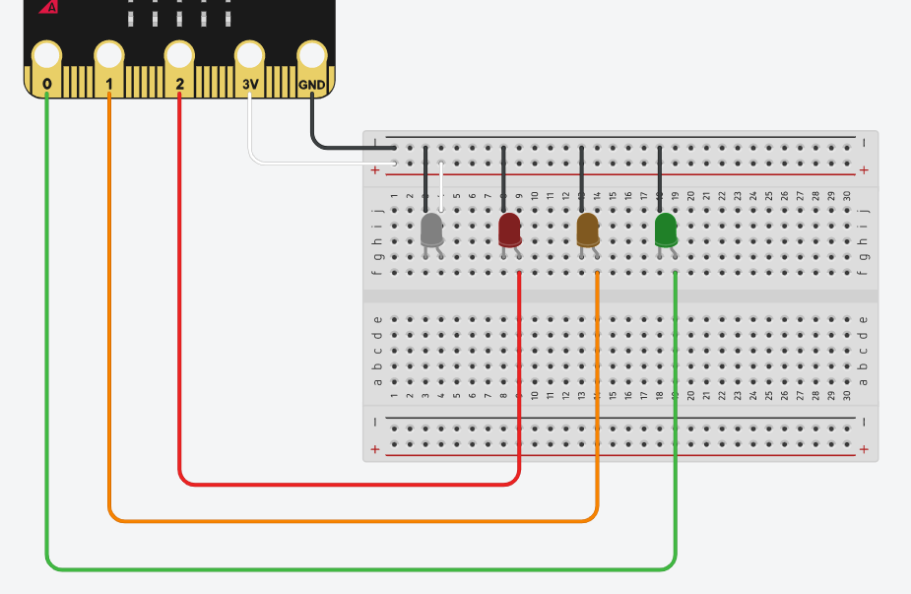
Why use a Breadboard?

Slide 9
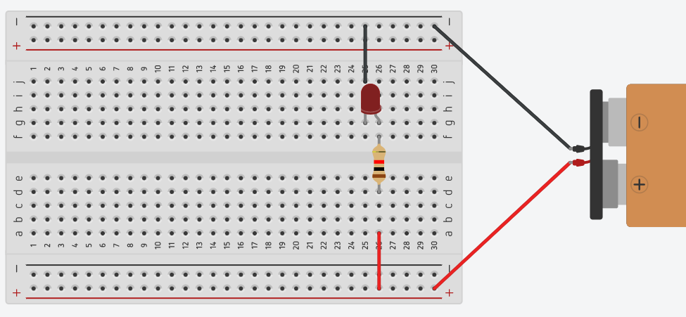
How to use a Breadboard:
+

Slide 10
How to use a Breadboard:

Slide 11
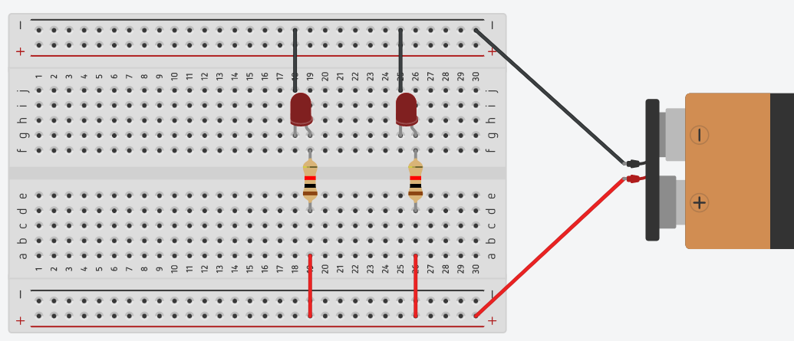
How to use a Breadboard:

Slide 12
How to use a Breadboard:

Slide 13
How to use a Breadboard:
+

Slide 14
How to use a Breadboard:
+

Slide 15
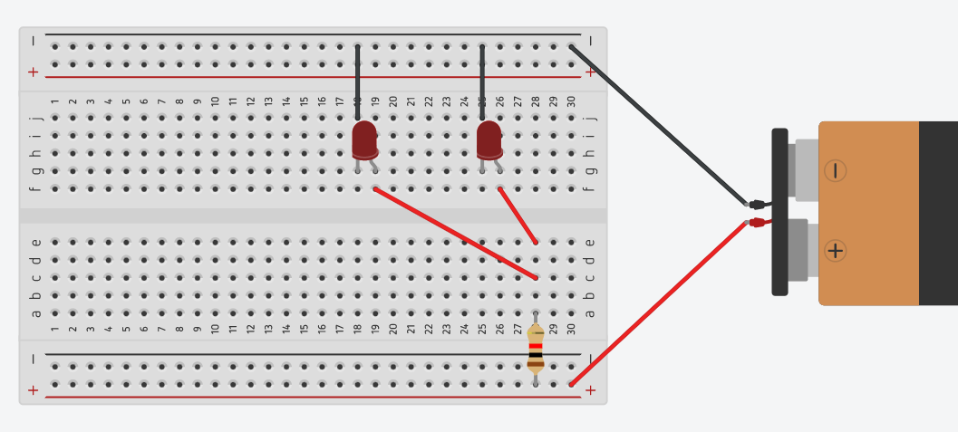
How to use a Breadboard:
+

Slide 16
How to use a Breadboard:

Slide 17
3-Pin Programmable Components

Slide 18
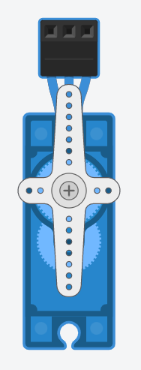
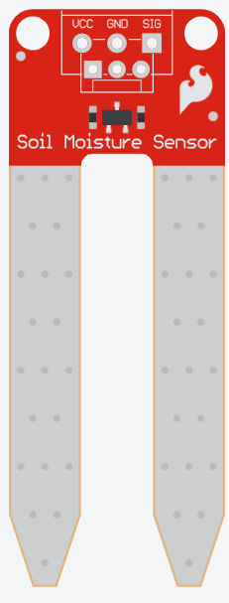
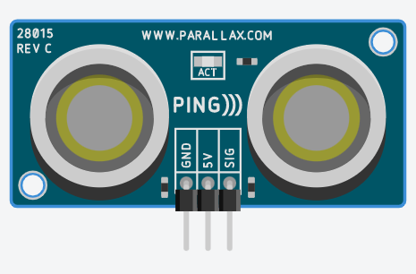
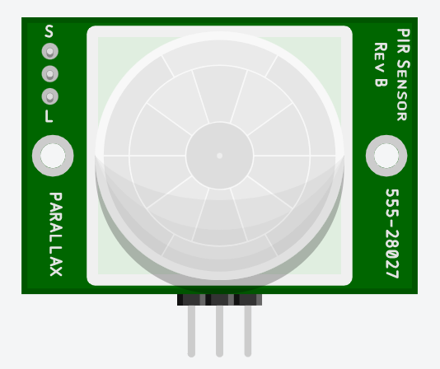
Examples of 3-Pin Programmable Components:
Power
Power
Power
Control
Control
Control
Ground
Ground
Power
Control
Ground
Ground

Slide 19
Wiring these 3-Pin Components:
BBC Micro:Bit
1 2 3 3V GND
Power
Control
Ground

Slide 20
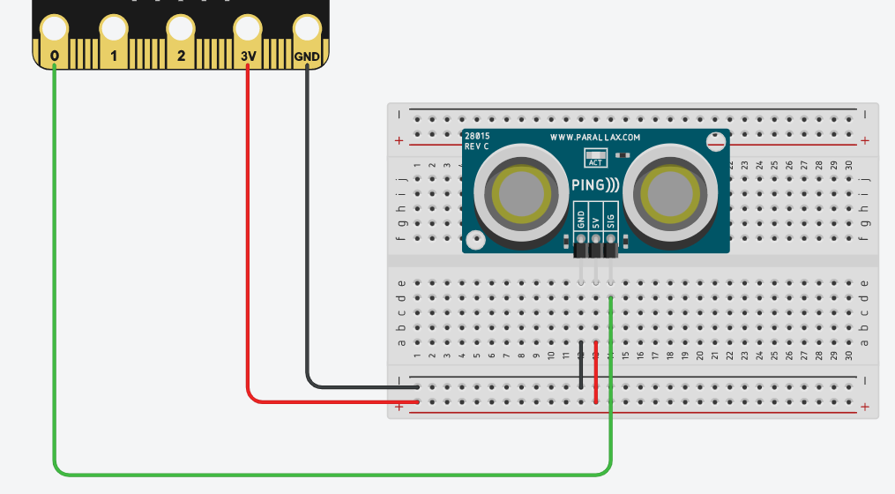
Wiring these 3-Pin Components:

Slide 21
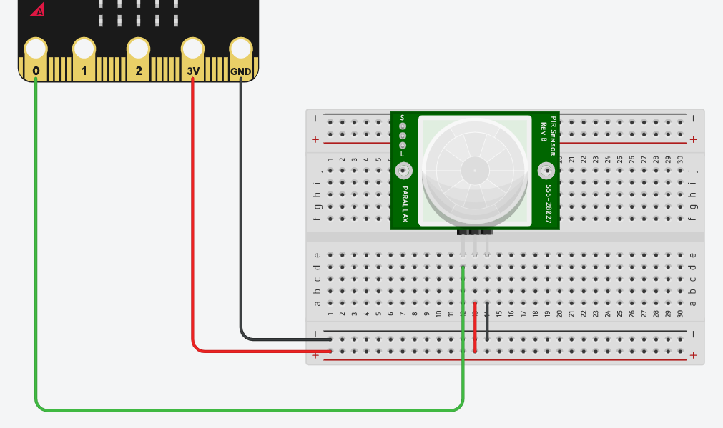
Wiring these 3-Pin Components:

Slide 22
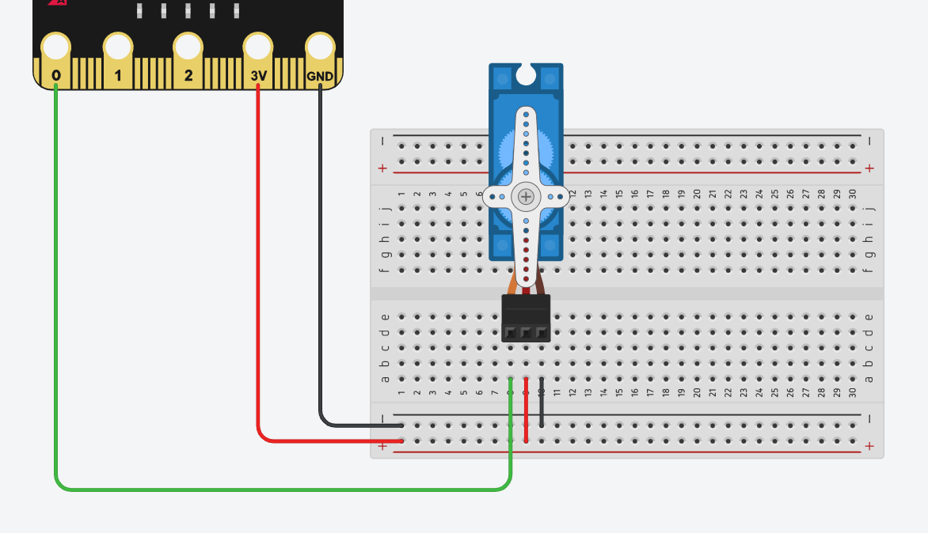
Wiring these 3-Pin Components:

Slide 23
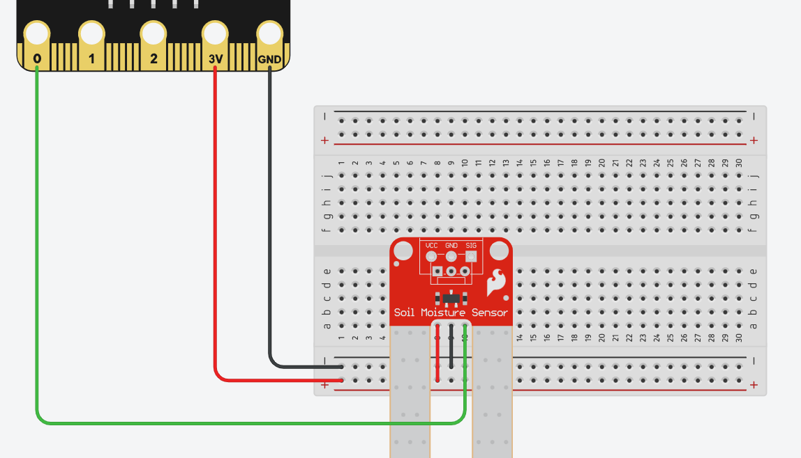
Wiring these 3-Pin Components:

Slide 24
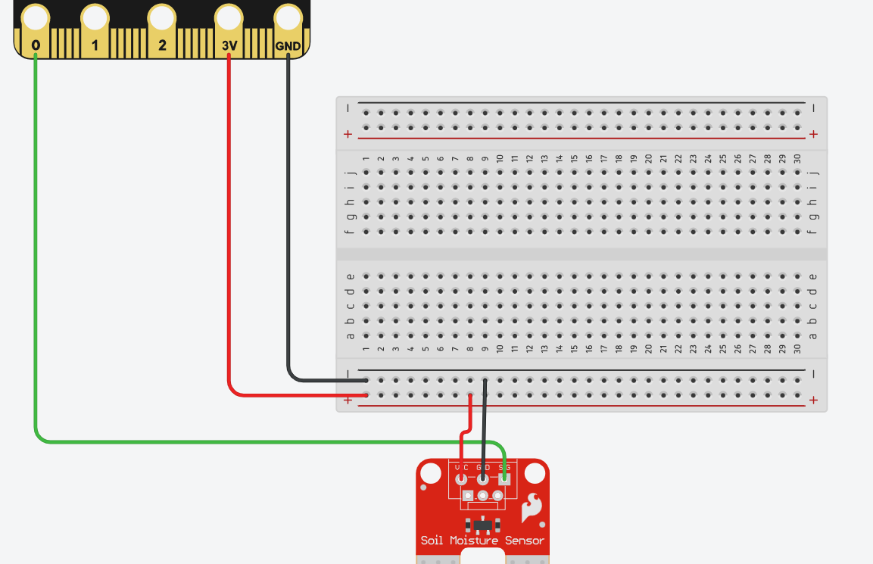
Wiring these 3-Pin Components:

Slide 25
Thank You

