Slide 1
Arduino circuits
Week 6 exercises

Slide 2
Ardunios
This week, we’ll be adding the Ultrasonic sensor to the set of components used with our Arduino
Practice block programming using the different components covered

Slide 3
BRONZE Challenge:
Step 1:
  Add a 4-pin Ultrasonic sensor and connect it to an arduino using a breadboard
  Write a program to print out the distances coming from the Ultrasonic sensor

Slide 4
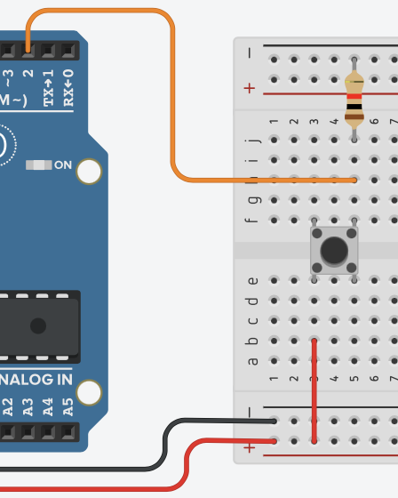
BRONZE Challenge:
Step 2:
  Add a push button to your breadboard and connect it to the Arduino
  Add an LED to your breadboard and connect it to the Arduino
  In your program, create a variable called On
  When the button is pressed, it should switch the value stored in On between HIGH and LOW
  If On is HIGH, your LED should turn on and you should print out the readings from the sensor

Slide 5
BRONZE Challenge:
Step 3:
  Add a second LED to your breadboard and connect it to your Arduino
    The LED will be used for digital output
  Update your program to turn on the second LED when something is detected by the Ultrasonic sensor within 100cm ONLY when the state is On

Slide 6
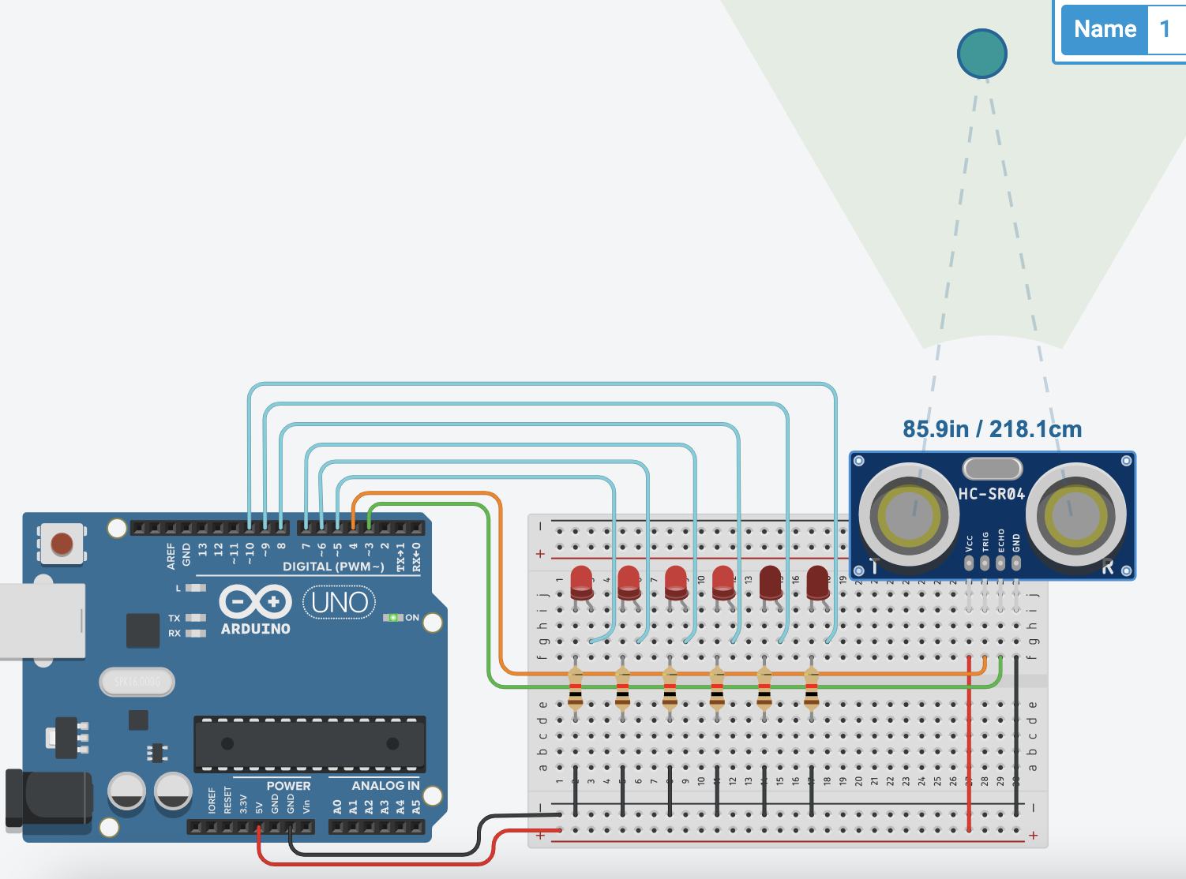
SILVER Challenge:
In a new circuit:
Step 1:
  Add an ultrasonic sensor and 6 LEDs

Slide 7
SILVER Challenge:
Step 2:
  Use the LEDs to show how far away something is detected with the Ultrasonic sensor, e.g.:
    0-50cm no lights
    50-100cm 1 light
    100-150cm 2 lights
    …

Slide 8
GOLD Challenge:
In a new circuit:
Step 1:
  Add the following components connected to an ardunino using an breadboard:
    RGB LED (analog output)
    Potentiometer
    LDR (Photoresistor) and
    Ultrasonic sensor

Slide 9
GOLD Challenge:
Write a program to change the colours on the RGB LED as follows:
  Red controlled by input from Potentiometer
  Green controlled by input from LDR
  Blue controlled by input from Ultrasonic
Remember to use the map function for the input
  You may need to switch to Text based programming to modify ranges for maps input

Slide 10
Extension Challenge 1
Ear bleeding challenge:
  Make a musical instrument using the ultrasonic sensor and piezo buzzer
    Make the tone change based on the distance returned by the ultrasonic sensor

Slide 11
Extension Challenge 2
Create a new circuit in TinkerCAD.
Connect a piezo buzzer to an Arduino (with a breadboard)
Program the Arduino to play a simple short tune with the piezo buzzer – See next slide for the values needed to play notes.

Slide 12
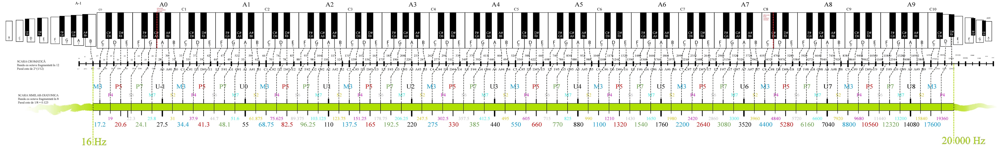
Extension Challenge 2

Slide 13
Extension Challenge 3
Try and recreate this piece – you’ll need 3 piezo buzzers. Extended keyboard mappings are on the next slide, sort of.

Slide 14
Extension Challenge

