Slide 1
Intro to Circuits
Advanced group: Week 5 exercises

Slide 2
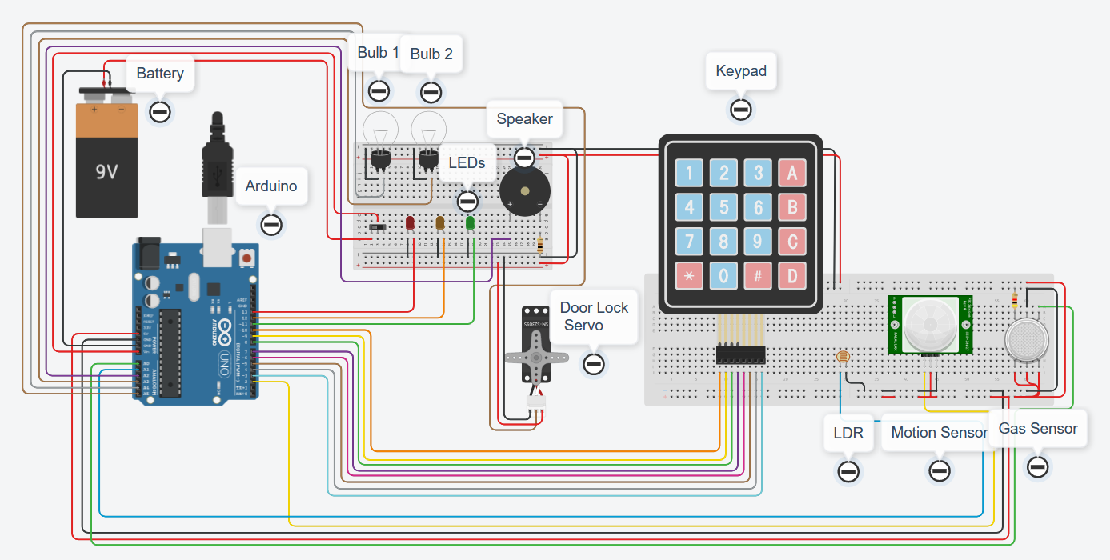
Aims:
Let’s wire up a house!
Smart home
Interconnected sensors
Google home/Alexa
Multipurpose buttons

Slide 3
The plan:
Week 1 – Arduino, battery, breadboard and lights
Week 2 – LDR, motion sensor, gas sensor
Week 3 – LDR, motion sensor, gas sensor
Week 4 – LDR, motion sensor, gas sensor / Door lock servo, keypad
Week 5 – Door lock servo, keypad
Week 6 – Door lock servo, keypad

Slide 4
Tips:
Use functions as much as possible, much easier and tidier to work with
Try to keep the virtual wires as tidy as possible, and colour code them ☺
Test as much of the code and circuit as possible – use the serial monitor and Serial.print()
Ask questions if you’re stuck ☺

Slide 5
Start thinking about how you might want to go about controlling a smart home from a control panel (keypad).
Which sensors should be automated?
Which components would you want manual control using the keypad?
BRONZE Challenge:

Slide 6
SILVER Challenge:
Using the functions you have created in the last few weeks, create some automated behaviours (inside the loop() ):
Turn the bulbs on or off dependent on sunrise or sunset (LDR sensor)
Turn on the bulbs and flash the orange LED on motion (pir sensor)
Turn on the bulbs and flash the red LED on detection of smoke (smoke sensor)

Slide 7
GOLD Challenge:
Using the functions you have created in the last few weeks, create some manual behaviours (inside the loop() ):
Turn the bulbs on or off using a button press from the keypad
Create a door lock where you have to press the correct combination of buttons to unlock the door (Servo).

Slide 8
Extension challenge
Create some code that will prevent you from unlocking the door or turning lights on or off etc. without pressing the correct combination of buttons on the keypad (lock someone out of the control panel).
Sound an alarm if someone gets the password wrong!

Slide 9
Thank You

