Slide 1
Arduino circuits

Slide 2
Ardunios
This week, we’ll be using the Arduino to build and program some circuits

Slide 3
BRONZE Challenge:
Step 1:
Build a circuit using
an Arduino
a breadboard
a resistor and
an LED
Connect the +ve on the breadboard to 5V on the Arduino
Have the LED always on when the simulation is running

Slide 4
BRONZE Challenge:
Step 2:
Using the breadboard, connect another LED with resistor to pin 2 on the Arduino
In the program:
Delete the existing code in the forever loop
Add the code to make the new LED turn on and off every second (wait 500 ms)

Slide 5
SILVER Challenge:
Step 1:
Add two more LEDs (and resistors) to your breadboard
Connect the LEDs to pins 4 and 7 on the Arduino so you can program them

Slide 6
SILVER Challenge:
Step 2:
In your program, create a variable called “myNum”
Inside your forever loop, set the variable to use the Math command to pick a random number between 0 and 3
Using the Output command, print the myNum variable to the serial monitor
Using the if-then-else blocks from the Control menu, turn on the number of LEDs to match the random number generated
Note, you will need to “nest” these in the else-blocks (or switch to text-only mode
Remember to add a wait block to slow down the loop so you can see the LEDs changing

Slide 7
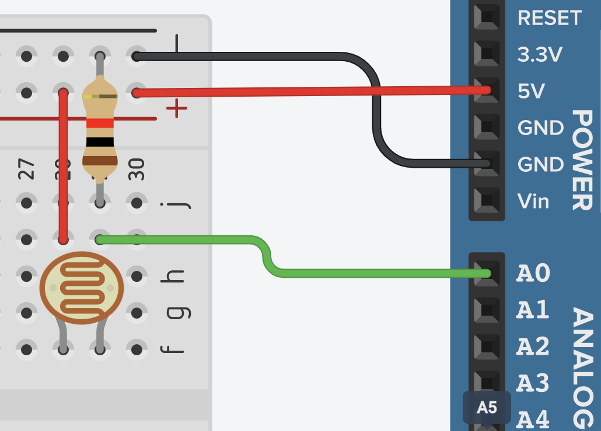
GOLD Challenge:
In a new Circuit, step 1:
Add an LDR (photo resistor) and use a breadboard to connect it to an Arduino
Create a variable and set it to the analog reading from the LDR
Print out the values from the variable to the Serial monitor
What is the range of values generated by the LDR?

Slide 8
GOLD Challenge:
Step 2:
Add an LED to your breadboard and connect it to your Arduino
Turn the LED on when the LDR reading is less than the middle of its range

Slide 9
Extension Challenge 1
Create a new circuit that takes input from a temperature sensor
Measure the range of values for the temperature sensor
Add three LEDs so you have a blue, white and red LED
If the temp < 0°C turn on the Blue LED
else if the temp < 35°C turn on the White LED
else turn on the Red LED

Slide 10
Extension Challenge 2
Modifying the circuit with the LDR
Change the LED to connect to a pin with a “~” in front of the number
Instead of simply turning the LED on / off, try setting the output to the pin to be a number between 0 and 255. Try different numbers to see what happens
255 is equivalent to “HIGH”, whilst 0 equates to “LOW”. This is a different range of values to that from the LDR
Using the Math map function, try taking the LDR value and setting the brightness of the LED
Note, you will need to switch to Text-Only mode to set the correct range for the LDR

