Slide 1
Intro to Circuits
Advanced group: Week 4 exercises

Slide 2
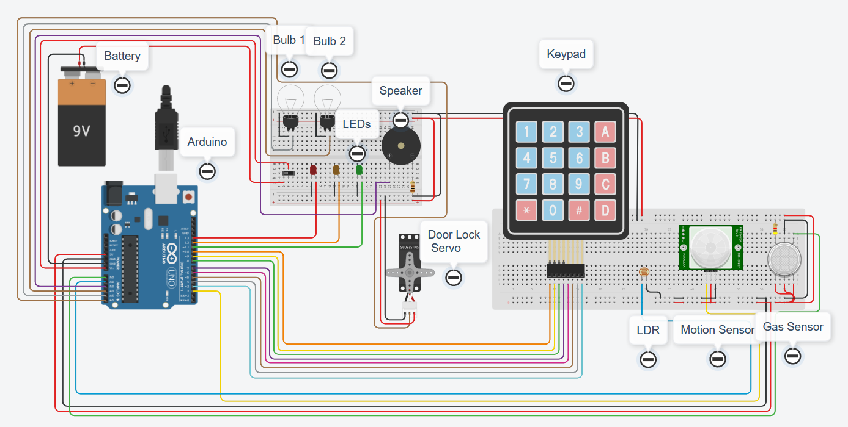
Aims:
Let’s wire up a house!
Smart home
Interconnected sensors
Google home/Alexa
Multipurpose buttons

Slide 3
The plan:
Week 1 – Arduino, battery, breadboard and lights
Week 2 – LDR, motion sensor, gas sensor
Week 3 – LDR, motion sensor, gas sensor
Week 4 – LDR, motion sensor, gas sensor / Door lock servo, keypad
Week 5 – Door lock servo, keypad
Week 6 – Door lock servo, keypad

Slide 4
Tips:
Use functions as much as possible, much easier and tidier to work with
Try to keep the virtual wires as tidy as possible, and colour code them ☺
Test as much of the code and circuit as possible – use the serial monitor and Serial.print()
Ask questions if you’re stuck ☺

Slide 5
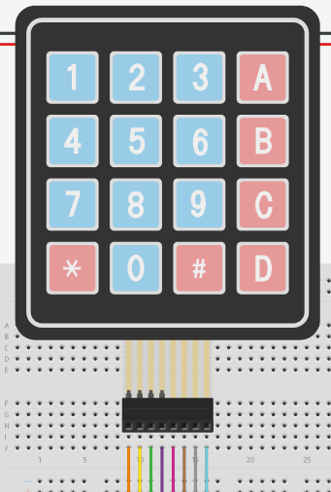
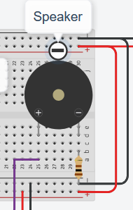
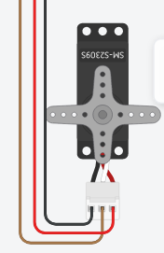
We are not expecting you to complete these challenges within a week!
Take your time and visit previous week worksheets if you need to check circuits/code.
Add the following components to your circuit
Piezo (buzzer)
Micro Servo
Keypad 4x4
BRONZE Challenge:

Slide 6
BRONZE Challenge:
Add the Piezo buzzer to the breadboard (to the lights breadboard, if there’s space) – connect the left leg of the piezo to the Arduino pin A2. Connect the right leg to a 100-ohm resistor which then connects to ground.
Add the servo to the circuit, connect the servo ground pin to the ground pin of a breadboard, connect the Signal pin to Arduino pin A5, finally connect the Power pin to the 5v power on a breadboard.
Go to the next page for the Keypad circuit.

Slide 7
BRONZE Challenge:
The Keypad has a lot more wires to plug in to our Arduino, luckily they are all digital signals coming from the switch (on/off).
Connect the Keypad to the breadboard.
Connect the following Keypad pins to the Arduino:
Row 1 → 10
Row 2 → 9
Row 3 → 8
Row 4 → 7
Column 1 → 6
Column 2 → 5
Column 3 → 4
Column 4 → 3

Slide 8
SILVER Challenge:
Let’s begin programming…
Make sure you are using the text editor (not blocks) – Arduino C is a lot more flexible than blocks.
Define the OUTPUT for the Piezo buzzer, in the setup function.
Create a new function to sound the Piezo if there is motion detected
Create another function to sound the Piezo if there is gas detected
The Piezo uses frequencies to create sound:
List of frequencies can be found at:
https://aberrobotics.club/docs/workshops/electronics/pitches.txt copy the content to the top of the code
tone(piezoPin, frequency, noteDuration); //play
delay(noteDuration); //for duration
noTone(piezoPin); //no note

Slide 9
SILVER Challenge:
The Servo uses a code library to provide some pre-built functions for you.
Click the libraries button, the find the servo library, click include.
The servo will act as our door lock, 0 degrees will be unlocked, 180 degrees locked.
Create two functions for locking and unlocking the door.
Remember to attach the servo in the setup function:
Servo myDoorLock;
void setup() {
myDoorLock.attach(A5);
}
void loop() {
myDoorLock.write(180);
}

Slide 10
GOLD Challenge:
The Keypad also has its own library. Add the library and include ‘Keypad’.
First we need to add the numbers of columns and rows i.e. 4
Then add an array, to show the library the layout of buttons
Add another array to show how the buttons match up with the Arduino pins
Bring all the info together to create the keypad in software
const byte numRows= 4; //number of rows
const byte numCols= 4; //number of columns
char keymap[numRows][numCols]=
{
{'1', '2', '3', 'A'},
{'4', '5', '6', 'B'},
{'7', '8', '9', 'C'},
{'*', '0', '#', 'D'}
};
byte rowPins[numRows] = {10,9,8,7}; //Rows 0 to 3
byte colPins[numCols]= {6,5,4,3}; //Columns 0 to 3
Keypad myKeypad= Keypad(makeKeymap(keymap), rowPins, colPins, numRows, numCols);

Slide 11
GOLD Challenge:
Create a new function called controlPanel.
Inside will be the logic for detecting key presses.
The code above shows a new character variable being created, which calls a function inside the keypad library
If a key is pressed, print out the result on the serial monitor.
Remember to call controlPanel from the loop() function!
void controlPanel() {
char keypressed = myKeypad.getKey(); //get key pressed
if (keypressed != NO_KEY) { //if key pressed is not equal to no key
Serial.print("key pressed is ");
Serial.println(keypressed);
}
}

Slide 12
Extension challenge
Create some code that will add together the characters from the control panel into a ‘string’ of characters.
Try making a few if statements to control the LEDs based on button presses from the keypad.
Can you make a security alarm, whereby you have to enter the correct sequence of numbers/letters to unlock the house?

Slide 13
Thank You

