Slide 1
Breadboards and 3-Pin Components

Slide 2
Wiring and Programming a Smart Greenhouse
This week we shall work through the challenges to produce our own ‘smart greenhouses’ controlled by a Micro:Bit.

Slide 3
BRONZE Challenge:
Step 1. We need a red LED showing when the power is on. So, using a breadboard, recreate this circuit:
BBC Micro:Bit
1 2 3 3V GND
1 kΩ

Slide 4
BRONZE Challenge:
Step 2. Our plants need light. So we need to create a circuit where we can have a white LED shine when it’s dark.
Hint: You will need to program the Micro:Bit. If light level < 50, digital write P0 to HIGH.
BBC Micro:Bit
0 1 2 3V GND
1 kΩ
1 kΩ

Slide 5
SILVER Challenge:
Step 3. As we want to add more components, 3V will no longer be enough power. So we need to upgrade to a 9V battery:
Hint: There is an example for this on the next slide.
BBC Micro:Bit
0 1 2 3V GND
1 kΩ
1 kΩ
+
9V

Slide 6
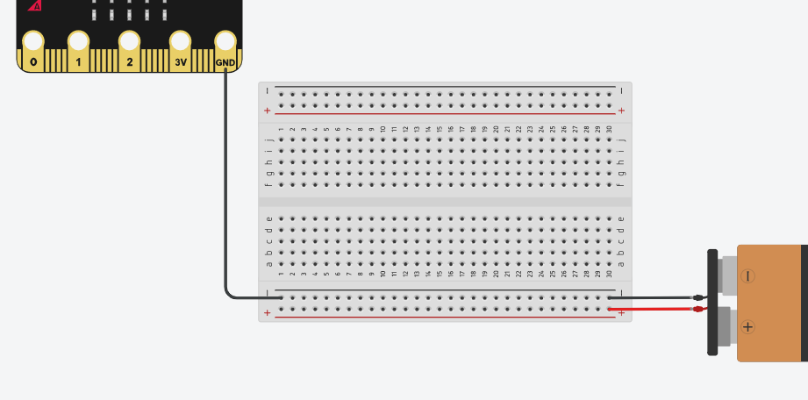
Adding a Battery:
Here is an example of how to connect both a Micro:Bit and a battery to a breadboard:

Slide 7
SILVER Challenge:
Step 4. Now we want to connect a soil moisture sensor to the circuit. This needs to be off the breadboard so it can be inserted into a plant pot.
BBC Micro:Bit
0 1 2 3V GND
1 kΩ
Power
1 kΩ
Control
+
9V
Ground

Slide 8
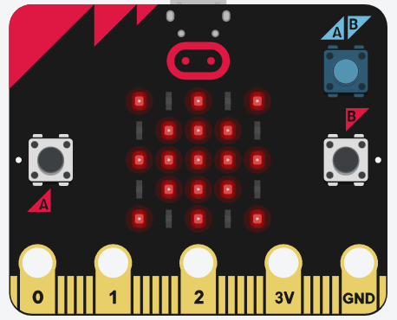
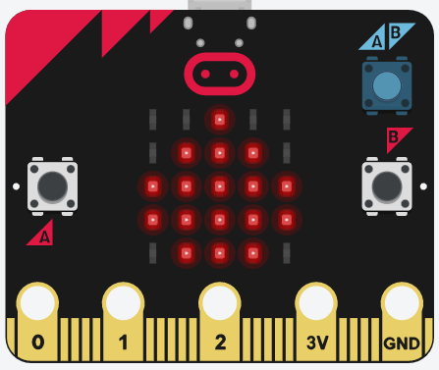
SILVER Challenge:
Step 5. Now program the Micro:Bit so if the soil is dry, a sun symbol appears on the screen. If the soil is damp, a raindrop symbol appears on the screen.
Hint: If read analog pin P1 < 75 then show sun symbol, else show raindrop symbol.

Slide 9
GOLD Challenge:
Step 6: We now need a servo connected to the breadboard and pin 2 of the Micro:Bit. This servo is turning a tap to release water when the soil is dry. To turn on the tap the servo needs to rotate 90°. To turn off, it needs to rotate back to 0°.

Slide 10
Congratulations!
You have now built and programmed a Micro:Bit controlled greenhouse!

Slide 11
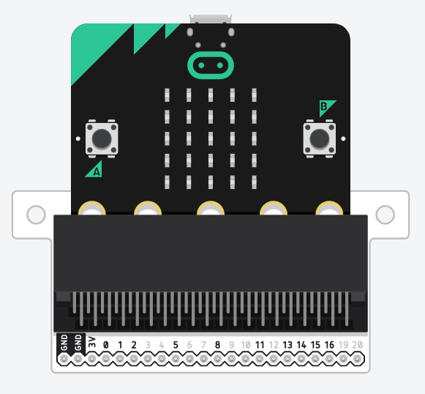
New Component:
Using the Micro:Bit with breakout board (as shown below), we can access more of the Micro:Bit’s pins. This increases the number of programmable pins in TinkerCAD to 10.

Slide 12
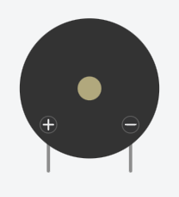
Extension Challenge:
Using the Micro:Bit breakout board, a breadboard, 3 LEDs, resistor(s), a 9V battery, and a piezo (a type of buzzer), create a traffic light system which beeps when it is safe for pedestrians to cross.
Remember: The traffic light sequence is: Red, red and amber, green, amber, repeat.
Piezo Buzzer
Buzzer Symbol

Slide 13
Extension Challenge:
Can you now draw the circuit diagram for you traffic light system? Send a photo of your drawing to crastaff@aber.ac.uk once completed.

Slide 14
Well Done!

