Slide 1
Intro to Circuits

Slide 2
Intro to Circuits

Slide 3
Series Circuits
Most of the circuits we’ve done so far are called series circuits. This means all the components are chained together in a single loop of wires.

Slide 4
BRONZE Challenge:
+
9V
Recreate this circuit in TinkerCAD:
What is the current in this circuit?
What voltage does each LED use?
A
1 kΩ

Slide 5
3V
Parallel Circuits
Here is an example of a parallel circuit:
+

Slide 6
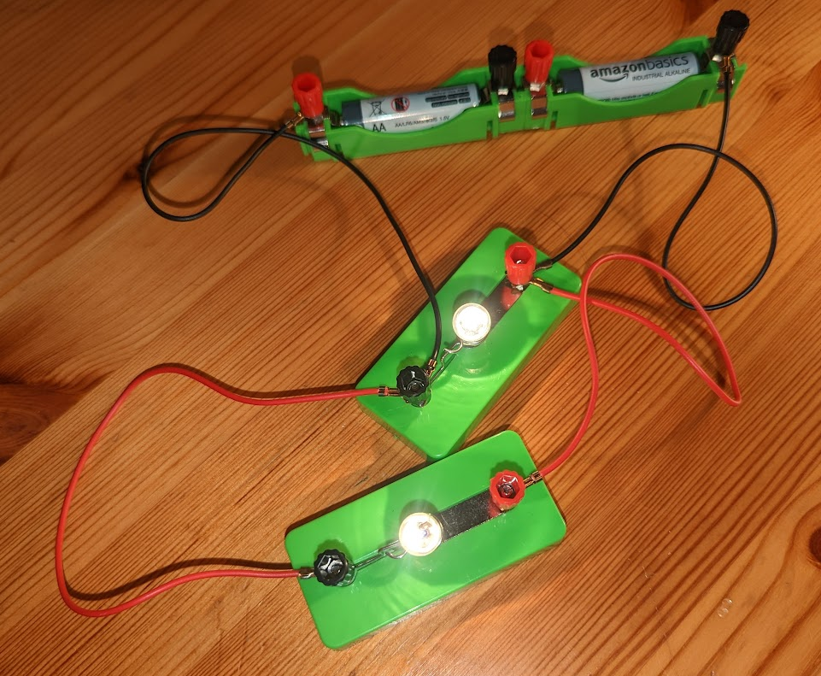
Parallel Circuits
And in real life:
Note: Voltmeters are connected in parallel in the same way.

Slide 7
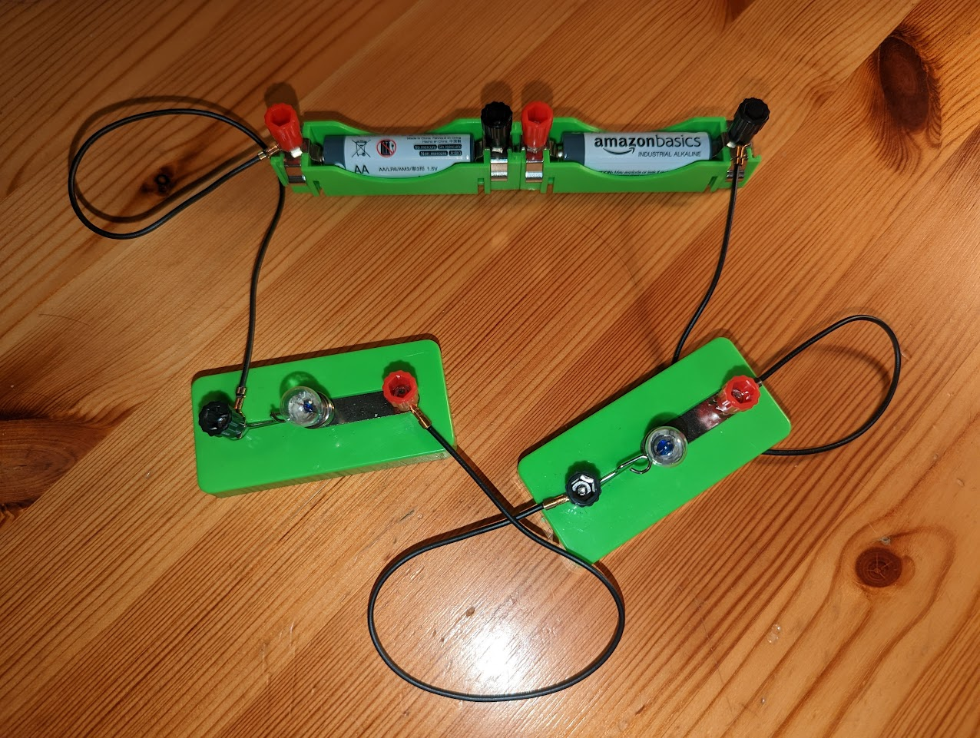
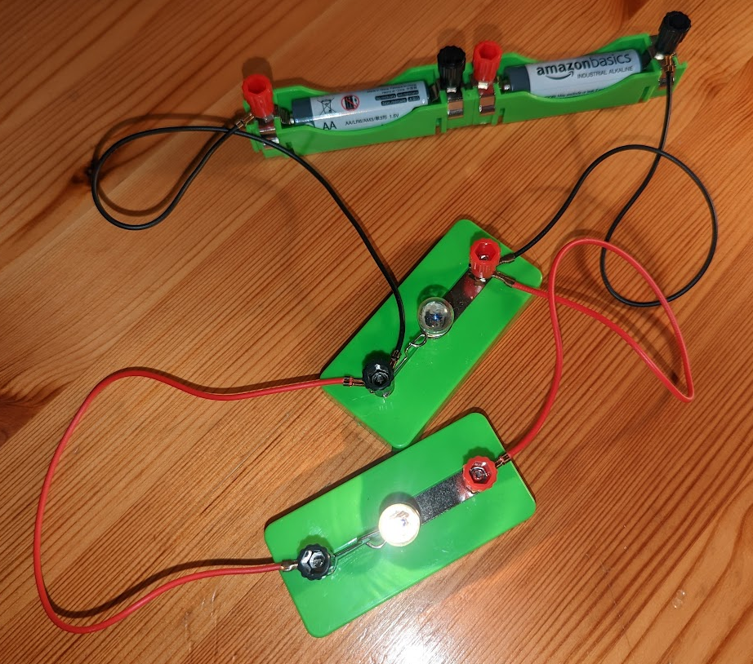
Series Vs Parallel Circuits
Below are examples of both circuits which include a broken lightbulb.
Note: Components in parallel will continue to work even if others are broken

Slide 8
SILVER Challenge:
+
9V
1. Recreate this circuit in TinkerCAD:
2. What voltage does each LED use?
A
1 kΩ

Slide 9
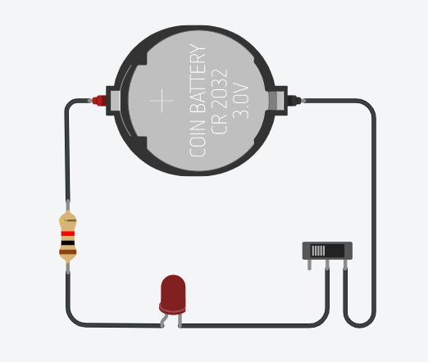
New Component: Slide Switch
Terminal 1
Terminal 2
Common
Reminder: An open (off) switch in a circuit diagram:

Slide 10
GOLD Challenge:
Design a circuit in TinkerCad which has 3 LEDS, each in parallel, powered by a 9V battery. Then add a slide switch so as 1 LED is always on whilst the other 2 are controlled by the slide switch.
What is the voltage through each LED when they are all on?
Open the switch (turn it off) and measure the voltage used by the lit LED.

Slide 11
RGB LED: Circuit Diagram Symbol
Red
Cathode
Blue
Green
Reminder: Cathodes connect to the negative side of the battery

Slide 12
Extension Challenge:
+
9V
1. Recreate this circuit in TinkerCAD to produce a green light.
2. Can you change the circuit so the RGB LED lights up yellow?
Hint: You’ll need to move the resistor
1 kΩ

Slide 13
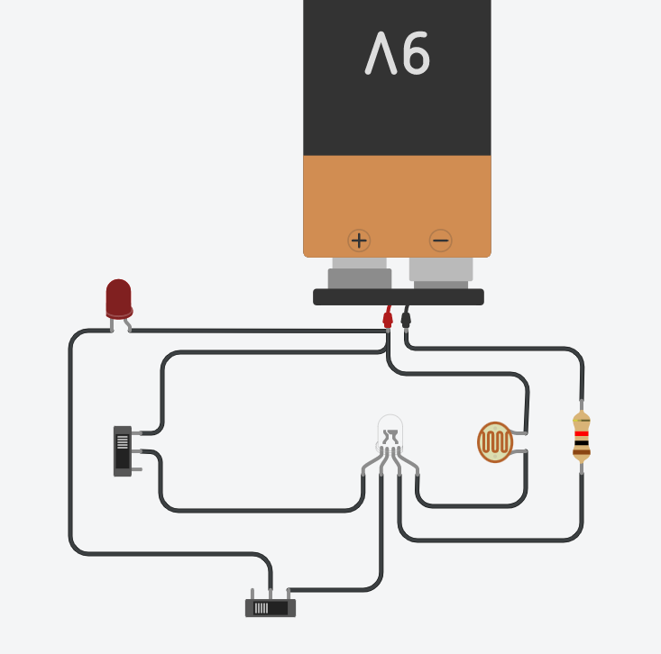
Extension Challenge:
Produce a circuit diagram for this TinkerCAD circuit. Please do this by hand and send a photo of your drawing to crastaff@aber.ac.uk
Hints: 1. Use a pencil!
2. Pay attention to the switch positions

Slide 14
Thank You

