Slide 1
Intro to Circuits
Advanced group: Week 2 exercises

Slide 2
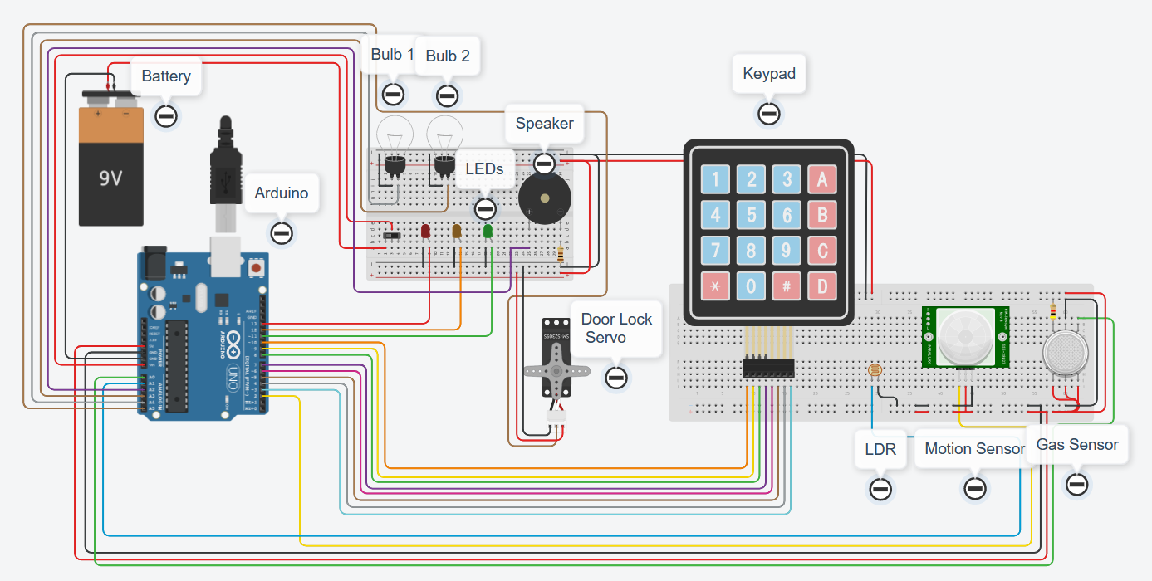
Aims:
Let’s wire up a house!
Smart home
Interconnected sensors
Google home/Alexa
Multipurpose buttons

Slide 3
The plan:
Week 1 – Arduino, battery, breadboard and lights
Week 2 – LDR, motion sensor, gas sensor
Week 3 – LDR, motion sensor, gas sensor
Week 4 – LDR, motion sensor, gas sensor / Door lock servo, keypad
Week 5 – Door lock servo, keypad
Week 6 – Door lock servo, keypad

Slide 4
Tips:
Use functions as much as possible, much easier and tidier to work with
Try to keep the virtual wires as tidy as possible, and colour code them ☺
Test as much of the code and circuit as possible – use the serial monitor and Serial.print()
Ask questions if you’re stuck ☺

Slide 5
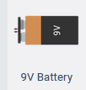
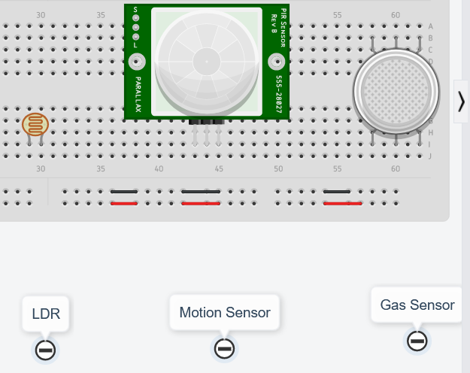
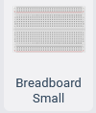
BRONZE Challenge:
Add the following components to your circuit
9 volt battery
Arduino
Bread board
LDR (photoresistor)
Motion sensor (PIR sensor)
Gas sensor

Slide 6
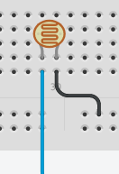
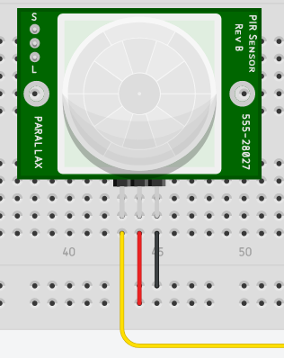
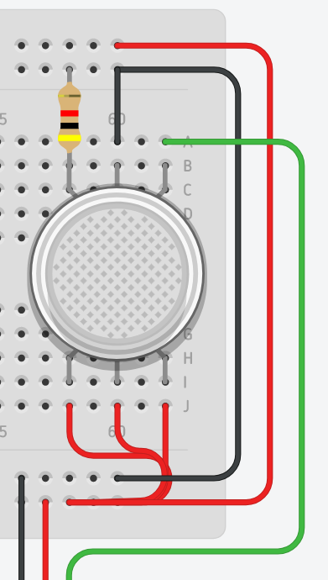
BRONZE Challenge:
Add the LDR to the breadboard – connect the left leg to pin A1 on the Arduino and the right leg to ground.
Next, add the motion sensor (PIR sensor) – connect the left leg to pin 2 on the Arduino, the middle leg to 5V power and the right leg to ground.
Finally, add the gas sensor – hover over the pins of the gas sensor to bring up the pin names
Connect pins B1, H2 and B2 to 5V power
Connect Terminal 1 to a 4 kilo-ohm resistor and connect the other end to ground
Connect pin H1 to ground and gas sensor pin A2 to Arduino pin A0.

Slide 7
SILVER Challenge:
Let’s begin programming…
Make sure you are using the text editor (not blocks) – Arduino C is a lot more flexible than blocks.
Define all the INPUTs for the LDR (photoresistor), motion sensor and gas sensor, using the pins on the bronze challenge
For the LDR, you will need to use:
pinMode(ldrPin, INPUT_PULLUP)
Where ldrPin is the name of your variable or pin number for the LDR

Slide 8
SILVER Challenge:
An LDR is an analogue component – it returns a different resistance depending on how much light is detected. The Arduino knows how to convert this to a voltage using:
analogRead(pin name);
Save the value coming from the LDR sensor to a variable and print it to the serial monitor.
(Remember to add Serial.begin(9600); to the setup function!)

Slide 9
SILVER Challenge:
The gas sensor is another analog device which detects carbon monoxide and carbon dioxide. The Arduino knows how to read the analog device using
analogRead(pin number);
Save the value coming from the gas sensor to a variable and print it to the serial monitor.

Slide 10
GOLD Challenge:
Now, we want to introduce our sensors to the lights we created last week.
Create 3 functions to read each sensor:
checkLightLevel();
checkForMotion();
checkForGas();
Create an if statement to turn the bulbs on when it gets dark
Create an if statement to turn the LEDs on when there’s motion
Create an if statement to turn on the bulbs and flash the LEDs when there’s gas.

Slide 11
Extension challenge
Create a program which will gradually increase the brightness of the bulbs when the sun sets (LDR value gets darker)
Create a program with two modes (day time and night time):
What kind of behaviours would you want to see from both?
Do you want the lights to turn on with motion during the day?
In an alarm system, do you want lights to flash when someone hasn’t left home?
Make these changes in your code, so that it acts like a ‘smarter’ home.

Slide 12
Thank You

