Slide 1
Intro to Circuits

Slide 2
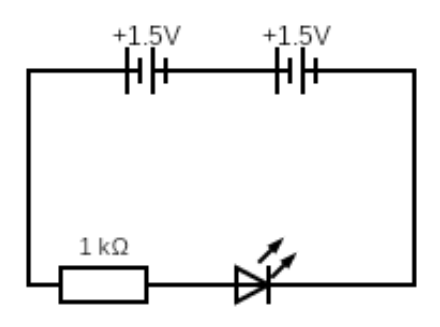
BRONZE Challenge:
Recreate this circuit in TinkerCAD:
+ 1.5V
+ 1.5V
1 kΩ

Slide 3
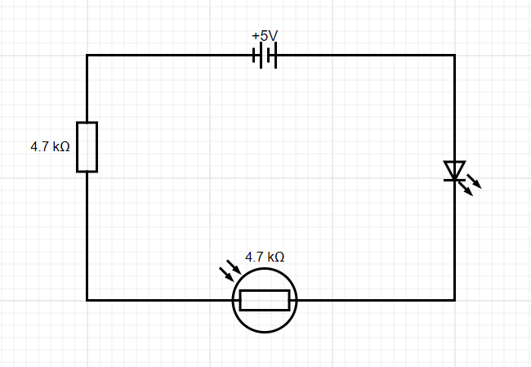
SILVER Challenge:
Recreate this circuit in TinkerCAD:
+ 3V
1 kΩ
What happens to the brightness of the LED when the light level is changed in the simulation?
An LDR is the same thing as a photoresistor

Slide 4
GOLD Challenge:
Recreate this circuit in TinkerCAD:
BBC Micro:Bit
1 2 3 3V GND
1 kΩ
1 kΩ
Which LED is programmable? Can you program it to turn on and off using the Micro:Bit’s A button?

Slide 5
Extension Challenge:
Create a circuit containing a resistor, a RGB LED, and a Micro:Bit.
RGB
LED
Each colour will need to be connected to a different pin on the Micro:Bit.
Red
Cathode
Blue
Green

Slide 6
Extension Challenge:
Once the circuit is complete, program it so as different Micro:Bit inputs result in the light shining different colours.
Can you figure out how to make the light shine yellow, magenta, cyan and white?

Slide 7
Thank You

