Slide 1
Intro to Circuits
Advanced group: Week 1 exercises

Slide 2
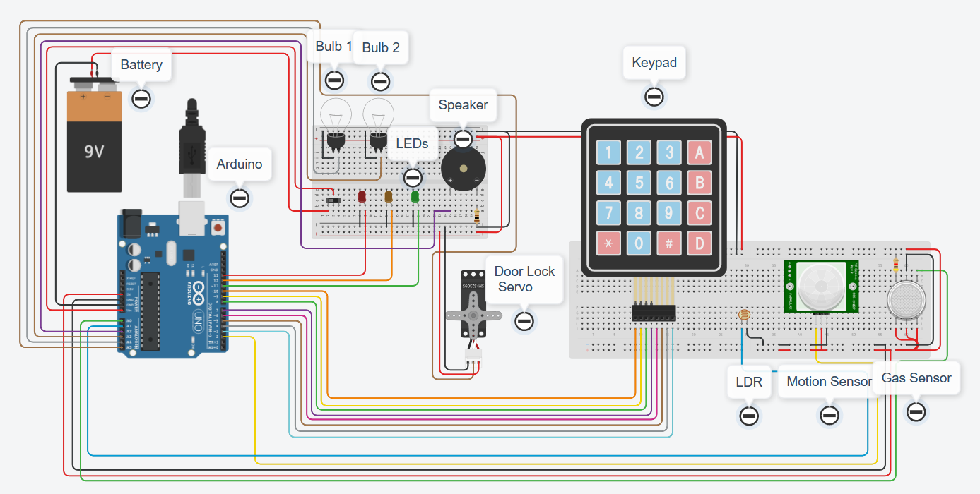
Aims:
Let’s wire up a house!
Smart home
Interconnected sensors
Google home/Alexa
Multipurpose buttons

Slide 3
The plan:
Week 1 – Arduino, battery, breadboard and lights
Week 2 – LDR, motion sensor, gas sensor
Week 3 – LDR, motion sensor, gas sensor
Week 4 – LDR, motion sensor, gas sensor / Door lock servo, keypad
Week 5 – Door lock servo, keypad
Week 6 – Door lock servo, keypad

Slide 4
Tips:
Use functions as much as possible, much easier and tidier to work with
Try to keep the virtual wires as tidy as possible, and colour code them ☺
Test as much of the code and circuit as possible – use the serial monitor and Serial.print()
Ask questions if you’re stuck ☺

Slide 5
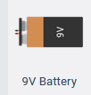
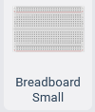
BRONZE Challenge:
Add the following components to your circuit
9 volt battery
Arduino
Bread board
3 LEDs
2 bulbs

Slide 6
BRONZE Challenge:
Connect the power terminals of the battery into the VIN and GND pins of the Arduino
Connect the 5V and GND pin from the Arduino to the power rails of the breadboard
Add the 3 LEDs to the breadboard, change the colours to red, orange and green
Connect the Cathode to the ground pin and the Anode to the Digital Pin for the Arduino:
Red LED – pin 13, orange LED – pin 12, green LED – pin 11

Slide 7
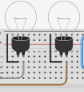
BRONZE Challenge:
Finally, connect up the two bulbs, connect terminal 1 to the ground power bar on the breadboard.
Connect terminal 2 on bulb 1 to pin A3, connect terminal 2 on bulb 2 to pin A4.
Are there any issues with the way we have wired anything up?

Slide 8
SILVER Challenge:
Let’s begin programming…
Make sure you are using the text editor (not blocks) – Arduino C is a lot more flexible than blocks.
Define all the OUTPUTs for the 3 LEDs and 2 bulbs, using the pins on the bronze challenge
Make all the lights turn on and off at the same time, with a 5 second delay.

Slide 9
GOLD Challenge:
Create a two functions for each LED and Bulbs:
One to turn the light on
One to turn the light off.
Create a program which flashes each light in sequence by calling these new functions e.g.
onRedLED();
delay(500);
offRedLED();
onOrangeLED();
delay(500);
offOrangeLED();
onGreenLED();
delay(500);

Slide 10
Extension Challenge:
Introduce a variable for each LED to save the state of whether it is on or off.
Add the ability to check whether LEDs are currently on or off (you could use the serial monitor).
If you turn on a certain light in the house, it means that you have moved rooms. So, create a program which turns off other lights.

Slide 11
Thank You

