Slide 1
Smart Home System
Building and programming an electronic system with a night-light and motion-activated burglar alarm.

Slide 2
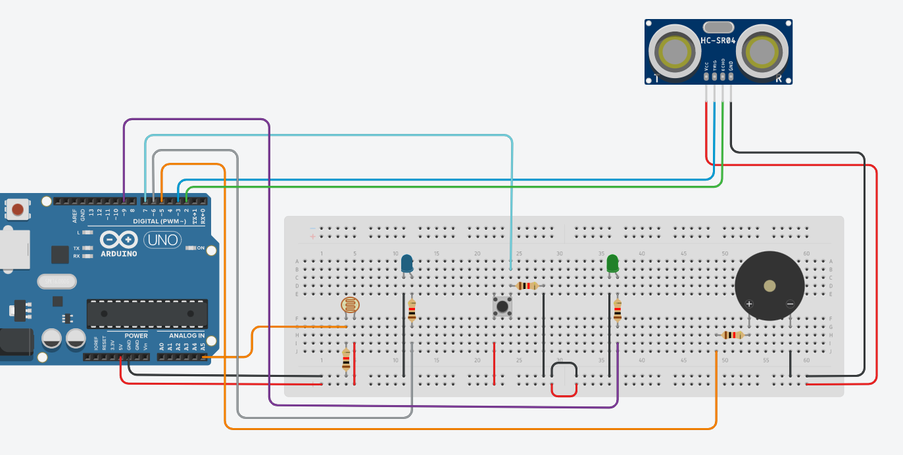
BRONZE Challenge:
Build the below circuit:
Electronic copy available in our Tinkercad Class

Slide 3
SILVER Challenge:
Important: All programming will need to be done using the blocks and text option on TinkerCAD – you can program in blocks but we need the text for uploading to your Arduino (instructions for uploading are provided on the next slide).
Program a night-light:
One of the LEDs needs to turn on when the LDR detects low levels of light.
Have this LED glow brighter as it gets darker

Slide 4
Connecting and Downloading to Arduino:
Important: Do not upload any programs to your Arduino until
your circuit has been checked and tested by a member of staff.
Step 1: Copy and paste the text code into Arduino IDE.
Step 2: Click on the tick in the top left to ‘compile’ code.
Step 3: Plug your Arduino into the computer.
Step 4: Click on the circle with an arrow to transfer.

Slide 5
GOLD Challenge:
Adding the burglar alarm:
When the ultrasound detects movement nearby, the piezo speaker sounds an alarm.
This alarm system should be turned on and off with the push-button.
The second LED lights up when the alarm system is turned on.

Slide 6
Extension Challenge
Changing the burglar alarm to a ‘Santa Detector’:
Change the program so that instead of a buzzer sound when movement is detected, it instead plays a festive tune.
Try this tune:
G – D – E – F – F – F – E – E – E – D – D – E – D – G – E – E – E – E – E – G – D – E – F – F – F – E – E – E – G – G – F – D

Slide 7
Extension Challenge

