Slide 1

Smart Home System
Building electronics and programming an
Arduino Smart Home

Slide 2
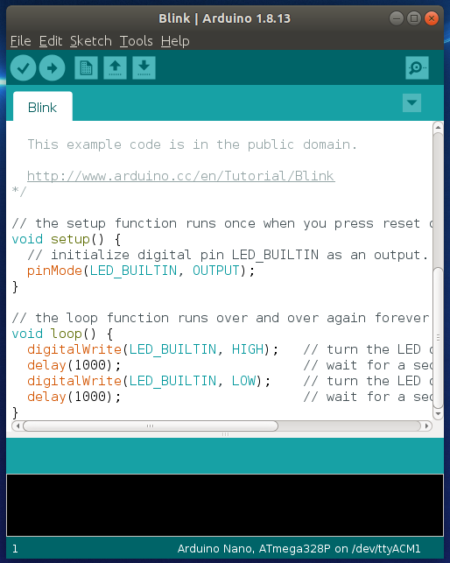

Connecting and Downloading to Arduino:
Important: Do not upload any programs to your Arduino until
your circuit has been checked and tested by a member of staff.
Step 1: Create and edit your code in the Arduino IDE.
Step 2: Click on the tick in the top left to ‘compile’ code.
Step 3: Plug your Arduino into the computer.
Step 4: Click on the circle with an arrow to transfer.

Slide 3
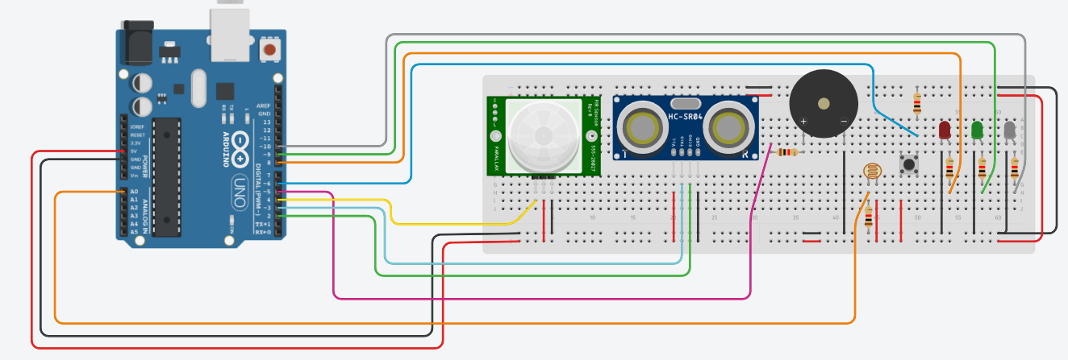
BRONZE Challenge:
Build the below circuit:
Electronic copy available in our Tinkercad Class

Slide 4
SILVER Challenge:
Important: All programming will need to be done using the Arduino IDE for uploading to your Arduino (instructions for uploading are provided on the next slide).
Our smart home has two different security modes – home and away, these modes will make the house behave differently dependent on the sensor data collected.
home – someone is home, automate things for the person’s convenience
away – no one is at home, secure the house and set any alarms.
Using the button on the breadboard, create a variable to switch the house from home to away and back, when pressed. You might want to use functions to contain your different house behaviours:
Turn on the red LED when the house is in away mode, turn the red LED off when in home mode.
2) When the house is in home mode, we would like the lights (white LED) to turn on when the sun sets in the evening, use the LDR sensor to determine when it gets dark.
When the house is in away mode, we don’t want the lights to turn on when no one is at home, let’s save some energy!
void armed() {
//add armed code
}
void disarmed() {
//add disarmed code
}

Slide 5
SILVER Challenge:
3) When the house is in away mode, we need to detect any intruders… use the PIR sensor to detect for motion. To warn people, make an alarm for the Piezo speaker and flash the orange LED.
When the house is in home mode, we might want to greet people arriving with some light to show the way, on motion turn on the white LED.

Slide 6
GOLD Challenge:
4) Next step is to detect if we have left any doors or windows open when the house is in away mode. We could use an ultrasonic sensor to determine the distance between the sensor and the window/door when it swings open.
Flash the red LED if the distance between the window/door and ultrasonic is large (i.e. it’s open)
5) Add a servo to your circuit which will act as our door lock. Automatically lock the door when the house goes into away mode. Unlock the door when it changes to home mode.

