Slide 1

Intro to NeoMatrix
Week 2 Exercises

Slide 2
Building and Programming robots in TINKERCAD
This week you be continuing to program the NeoMatrix through TinkerCAD. This workshop aims to develop your text programming skills.
Please complete the bronze requirements before starting the silver,
and complete the silver before starting the gold.

Slide 3
Neopixel and GFX APIs
NeoPixel: https://adafruit.github.io/Adafruit_NeoPixel/html/class_adafruit___neo_pixel.html
GFX API: http://adafruit.github.io/Adafruit-GFX-Library/html/class_adafruit___g_f_x.html#a59178a0e0c845a14a39b457c43567dd9

Slide 4
BRONZE Challenge:
Aims:
Using the list of functions given below, reproduce the images on the next few slides.
The colours used are limited to Red, Green and Blue.
matrix.clear();
matrix.fillScreen(matrix.Color(r,g,b));
matrix.fillRect(x, y, width, height, color);
matrix.drawRect(x, y, width, height, color);
matrix.fillCircle(center_x, center_y, radius, color);
matrix.drawCircle(center_x, center_y, radius, color);
matrix.show();

Slide 5
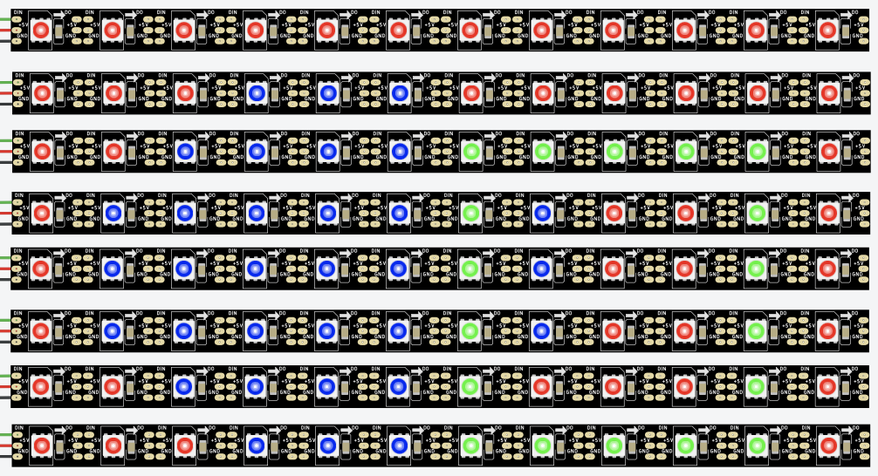
BRONZE Challenge:

Slide 6
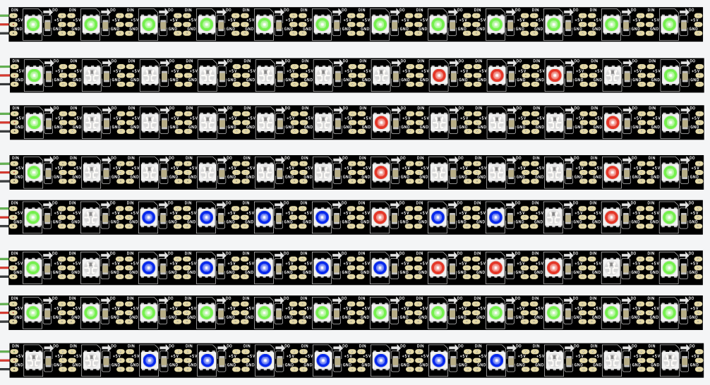
BRONZE Challenge:

Slide 7
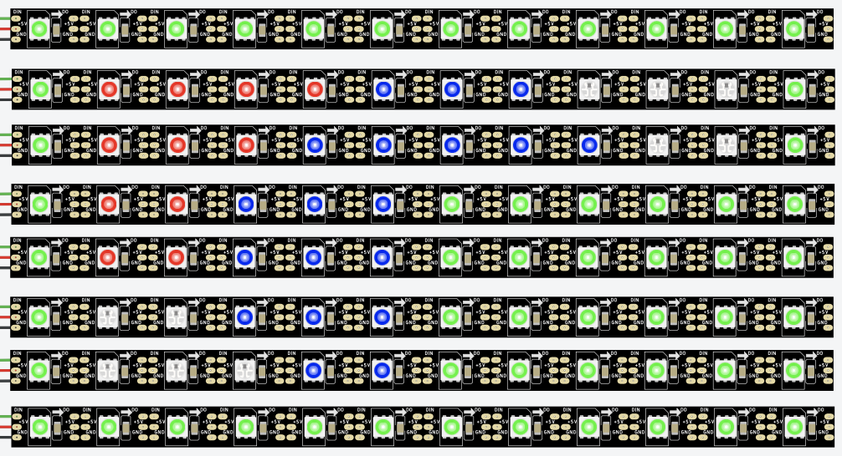
BRONZE Challenge:

Slide 8
SILVER Challenge:
Aims:
Using the list of functions given below, write functions to draw the following set of pictures. The x,y coordinates for the top left corner of the picture should be given as parameters for the function
matrix.clear();
matrix.fillScreen(matrix.Color(r,g,b));
matrix.drawPixel(x,y,matrix.Color(r,g,b));
matrix.fillRect(x, y, width, height, color);
matrix.drawRect(x, y, width, height, color);
matrix.fillCircle(center_x, center_y, radius, color);
matrix.drawCircle(center_x, center_y, radius, color);
matrix.show();

Slide 9
SILVER Challenge:
Pictures:

Slide 10
GOLD Challenge:
Steps:
Write a function that will return the next colour in a rainbow sequence. The counter will need to be defined outside the function
Add a parameter for the function to specify how much to increment the counter by each time. A default value of 1 should be set
Use your function to fill the grid with a rainbow
Document the functions you have written here

Slide 11
Extension Challenge:
What else can you add to this program?
Add versions of existing functions that used the random colours to use the rainbow colour instead
Add additional images to draw. These can be of different sizes.

Slide 12
Thank You

