Slide 1
Intro to Valiant robots
Week 1 exercises

Slide 2
Building and Programming robots in TINKERCAD
This week you be introduced to the Valiant robots through TinkerCAD. This workshop aims to develop your text programming skills.
Please complete the bronze requirements before starting the silver, and complete the silver before starting the gold.

Slide 3
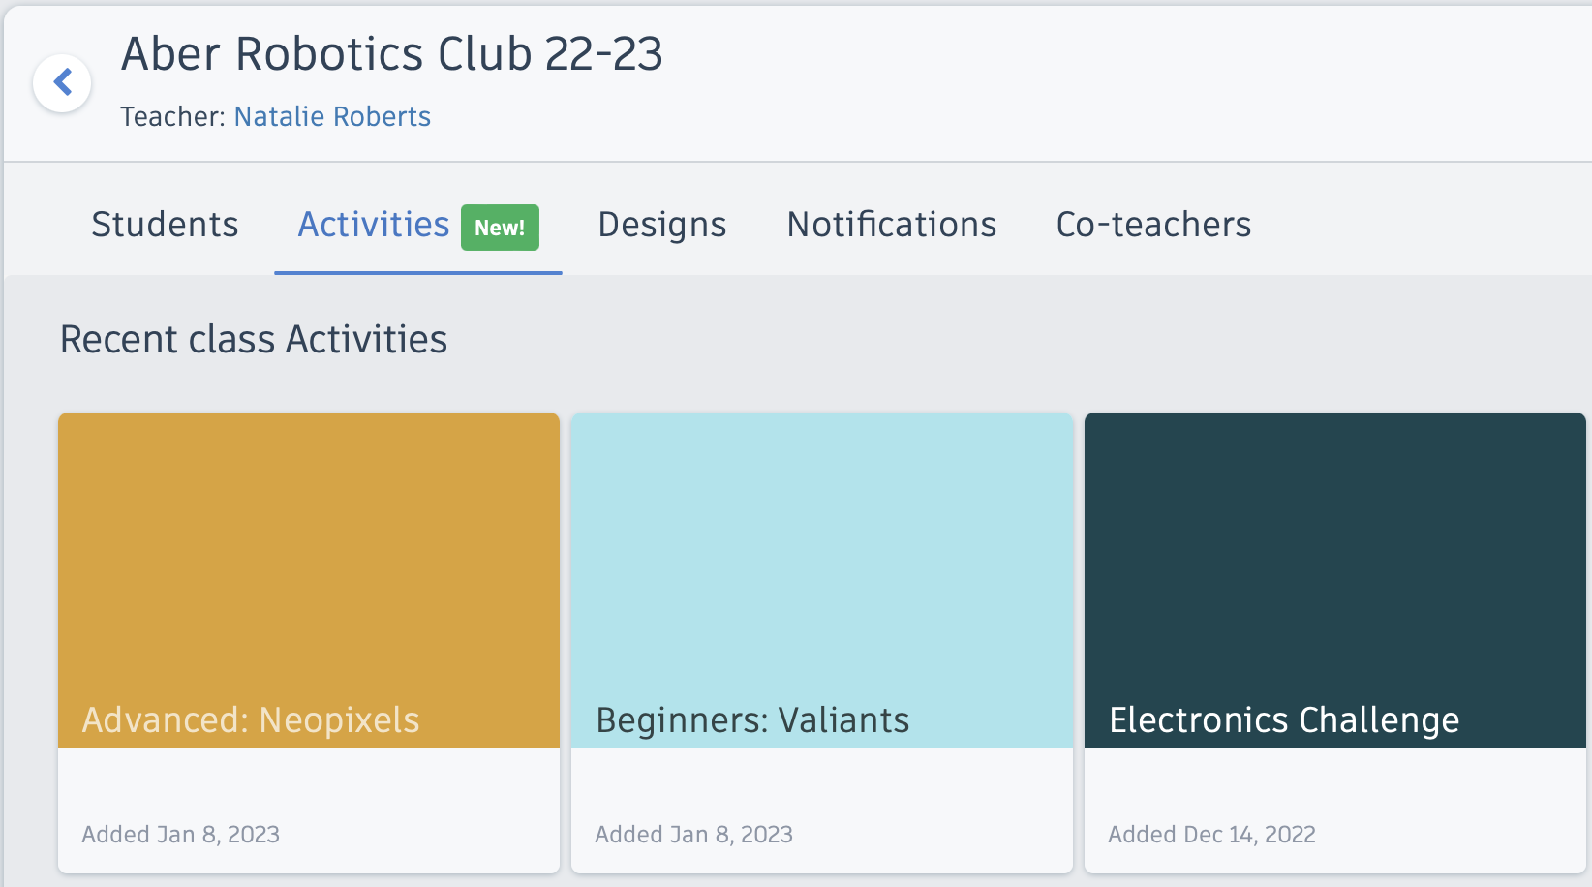
Getting Started
Activity containing pre-made circuit

Slide 4
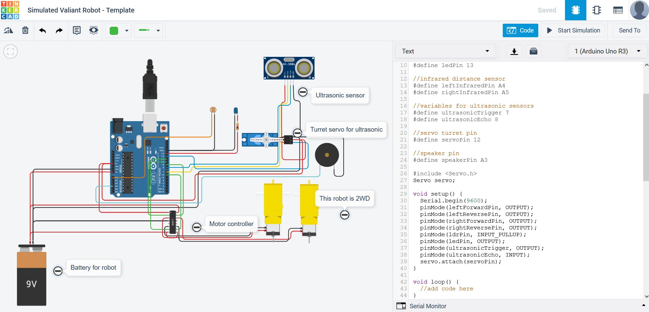
Edit the name of the circuit to include your name
Getting Started
Pre-made circuit is identical to robot for challenge day.
Make sure the code editor is set to Text

Slide 5
BRONZE Challenge:
Steps:
Inside the setup() function, define pin 13 as an output pin:
pinMode(13, OUTPUT);
Add code to the forever loop() to flash the LED on and off:
digitalWrite(13, HIGH);
delay(100);
...

Slide 6
SILVER Challenge:
Steps:
Inside the setup() function:
Add the pin mode to set the LDR pin (A0) as an input pin
pinMode(A0, INPUT);
Initialise the Serial monitor
Serial.begin(9600);
Above the setup() function:
Create a variable to store the readings from the LDR
int myInput = 0;

Slide 7
SILVER Challenge:
Steps:
Inside the loop() function:
Assign the reading from the LDR to your variable
myInput = analogRead(A0);
Print out the light level from the LDR to the serial monitor
Serial.println(myInput);

Slide 8
GOLD Challenge:
Aims:
Introduce various ‘bugs’ into your code to understand the error messages you get
One at a time, make the following modifications to your program then try to run the simulation to see what error message you get. Then fix the change before trying the next.
Try each change in a few different places
Remove a closing Curly bracket - }
Remove an opening Curly bracket – {
Remove a semi-colon - ;
Remove a pair of round brackets - ()
Introduce a spelling mistake

Slide 9
Extension Challenge:
What else can you add to this program?
Add variables to define the pins the LED and LDR are connected to. Use these variables instead of pin numbers in your program
In a previous circuit, with an LDR and LED, look at the text version of an if statement used to turn on the LED when it is dark. Try adding this to your new circuit.

Slide 10
Thank You

