Slide 1
Interactive NeoMatrix
Challenges

Slide 2
Building and Programming robots in TINKERCAD
Using the NeoMatrix through TinkerCAD. This workshop aims to develop your text programming skills.

Slide 3
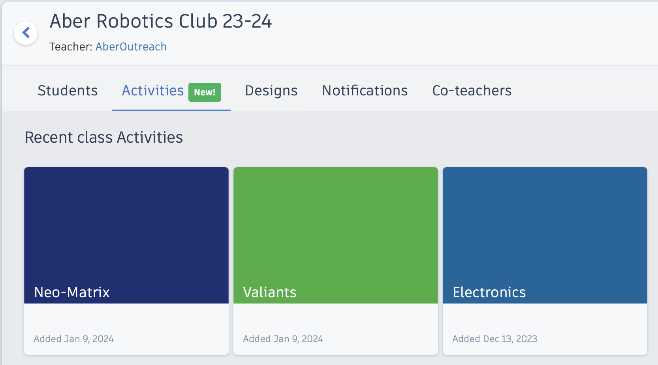
Getting started
Activity containing pre-made circuit

Slide 4
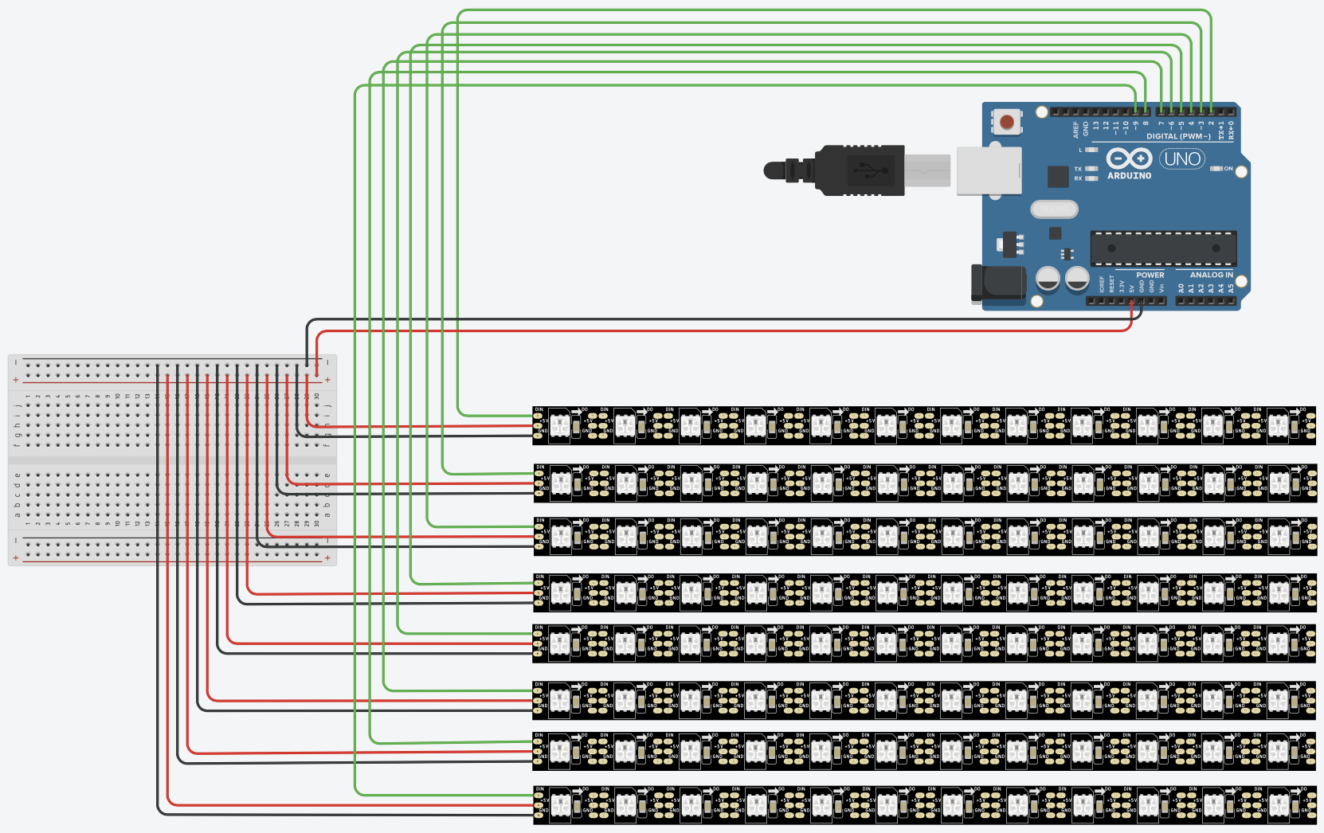
Getting Started

Slide 5
Neopixel and GFX APIs
NeoPixel: https://adafruit.github.io/Adafruit_NeoPixel/html/class_adafruit___neo_pixel.html
GFX API: http://adafruit.github.io/Adafruit-GFX-Library/html/class_adafruit___g_f_x.html#a59178a0e0c845a14a39b457c43567dd9

Slide 6
Key functions
matrix.fillScreen(matrix.Color(r,g,b));
matrix.drawPixel(x,y,matrix.Color(r,g,b));
matrix.fillRect(x, y, width, height, color);
matrix.drawRect(x, y, width, height, color);
matrix.fillCircle(center_x, center_y, radius, color);
matrix.drawCircle(center_x, center_y, radius, color);
matrix.getPixelColor(num)
matrix.clear();
matrix.show();

Slide 7
Notes on getPixelColour
Note, the matrix uses uint16_t colour range
The function getPixelColor(n) returns a colour in the range uint32_t
This will therefore be different to the number generated by matrix.Color(r,g,b);
As only a small range of colours are needed here, the best option is to save the uint32_t values generated for comparison

Slide 8
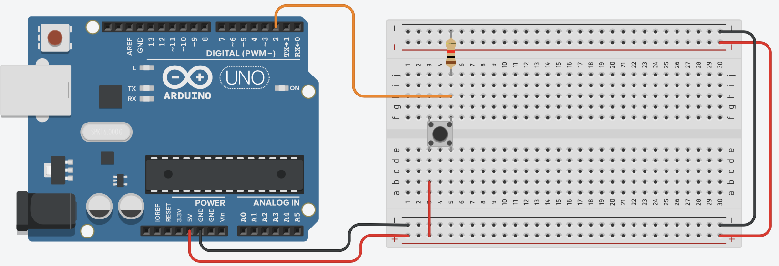
BRONZE Challenge:
Steps:
Add four buttons to the circuit on pins 10-13. Below is a reminder of how to wire in a button:

Slide 9
SILVER
Challenges
GOLD
Options:
This term, the aim is to develop one or more interactive games that can be played on the neomatrix. The neomatrix in TinkerCAD is 12x8 whilst the challenge day neomatrix is 32x8
Mastermind game https://en.wikipedia.org/wiki/Mastermind_(board_game)
Obstacle avoidance driving game
Space invaders game
Side scrolling platform game
Other ideas you may have

Slide 10
SILVER
Challenges
GOLD
Things to consider:
Orientation of the neomatrix, horizontal or vertical
Use of arrays for tracking current state of display
Functions for updating display, shifting image left/right/up/down
Levels of difficulty

