Slide 1
NeoMatrix Challenges
Playing with colours, shapes and animations

Slide 2
Warning
The individual neopixels are very bright!
Do not stare at the neomatrix, or look at it for too long at a time
Unplug the neomatrix when not testing
Do not increase the brightness set in the code

Slide 3
Getting started
The physical version of the neomatrix only requires a single pin to control it from the Arduino
We are also able to directly include the libraries to use it, that were not available on TinkerCAD
This makes the start of our program much simpler, but once started, the programs written will match the code written on TinkerCAD for the exercises this term

Slide 4
Initial Code
#include <Adafruit_NeoMatrix.h>
#define NEOPIXEL_PIN 6
const int width = 32;
const int height = 8;
Adafruit_NeoMatrix matrix = Adafruit_NeoMatrix(width, height, NEOPIXEL_PIN,
NEO_MATRIX_TOP + NEO_MATRIX_LEFT + NEO_MATRIX_COLUMNS + NEO_MATRIX_ZIGZAG,
NEO_GRB + NEO_KHZ800);

Slide 5
Setting up the neomatrix
/**
* Function to initialise arduino and neomatrix
*/
void setup() {
// Initialize the NeoPixel library.
matrix.begin();
matrix.setTextWrap(false);
matrix.setBrightness(7); // Don’t increase this value above 10
matrix.fillScreen(0);
matrix.show();
Serial.begin(9600);
}

Slide 6
Connecting and Downloading to Arduino:
Step 1: Copy and paste your text code into Arduino IDE. IMPORTANT: Only copy the necessary code, e.g. functions you have written
Step 2: Click on the tick in the top left to ‘compile’ code.
Step 3: Plug your Arduino into the computer.
Step 4: Click on the circle with a → arrow to transfer.
IMPORTANT: Disconnect your neomatrix when not using it

Slide 7
Available NeoMatrix drawing functions
matrix.fillScreen(matrix.Color(r,g,b));
matrix.drawPixel(x,y,matrix.Color(r,g,b));
matrix.fillRect(x, y, width, height, color);
matrix.drawRect(x, y, width, height, color);
matrix.fillCircle(center_x, center_y, radius, color);
matrix.drawCircle(center_x, center_y, radius, color);
matrix.clear();
matrix.show();

Slide 8
Available NeoMatrix text functions
matrix.drawChar (x, y, character, color, backgroundColor, size); //if backgroundColor same as color, no background drawn
matrix.setTextColor (color);
matrix.setTextColor (color, backgroundColor);
matrix.setCursor (x, y);
matrix.print(message);

Slide 9
BRONZE Challenge:
Reproduce the patterns from the next few slides on your neomatrix
Tip: Use a new function to draw each pattern

Slide 10
Bronze Challenge 1
Made using:
Colours: Red, Green and Blue
Functions: Fill screen, rectangles and circles

Slide 11
Bronze Challenge 1
Has the characters ‘A, ‘R’ and ‘C’ in blue, red and white, along with a red square and magenta circle, all on a green background

Slide 12
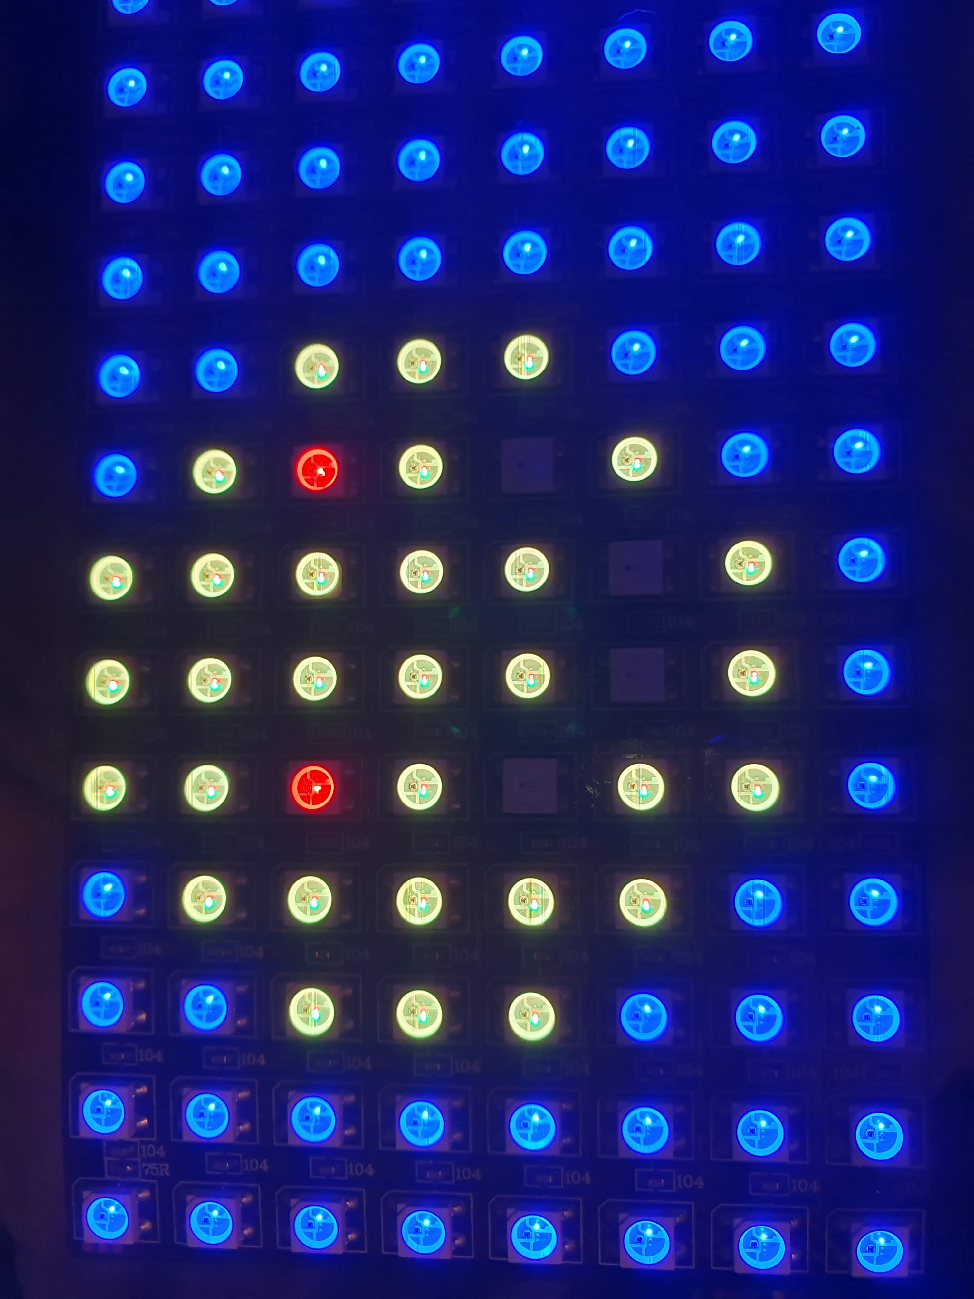
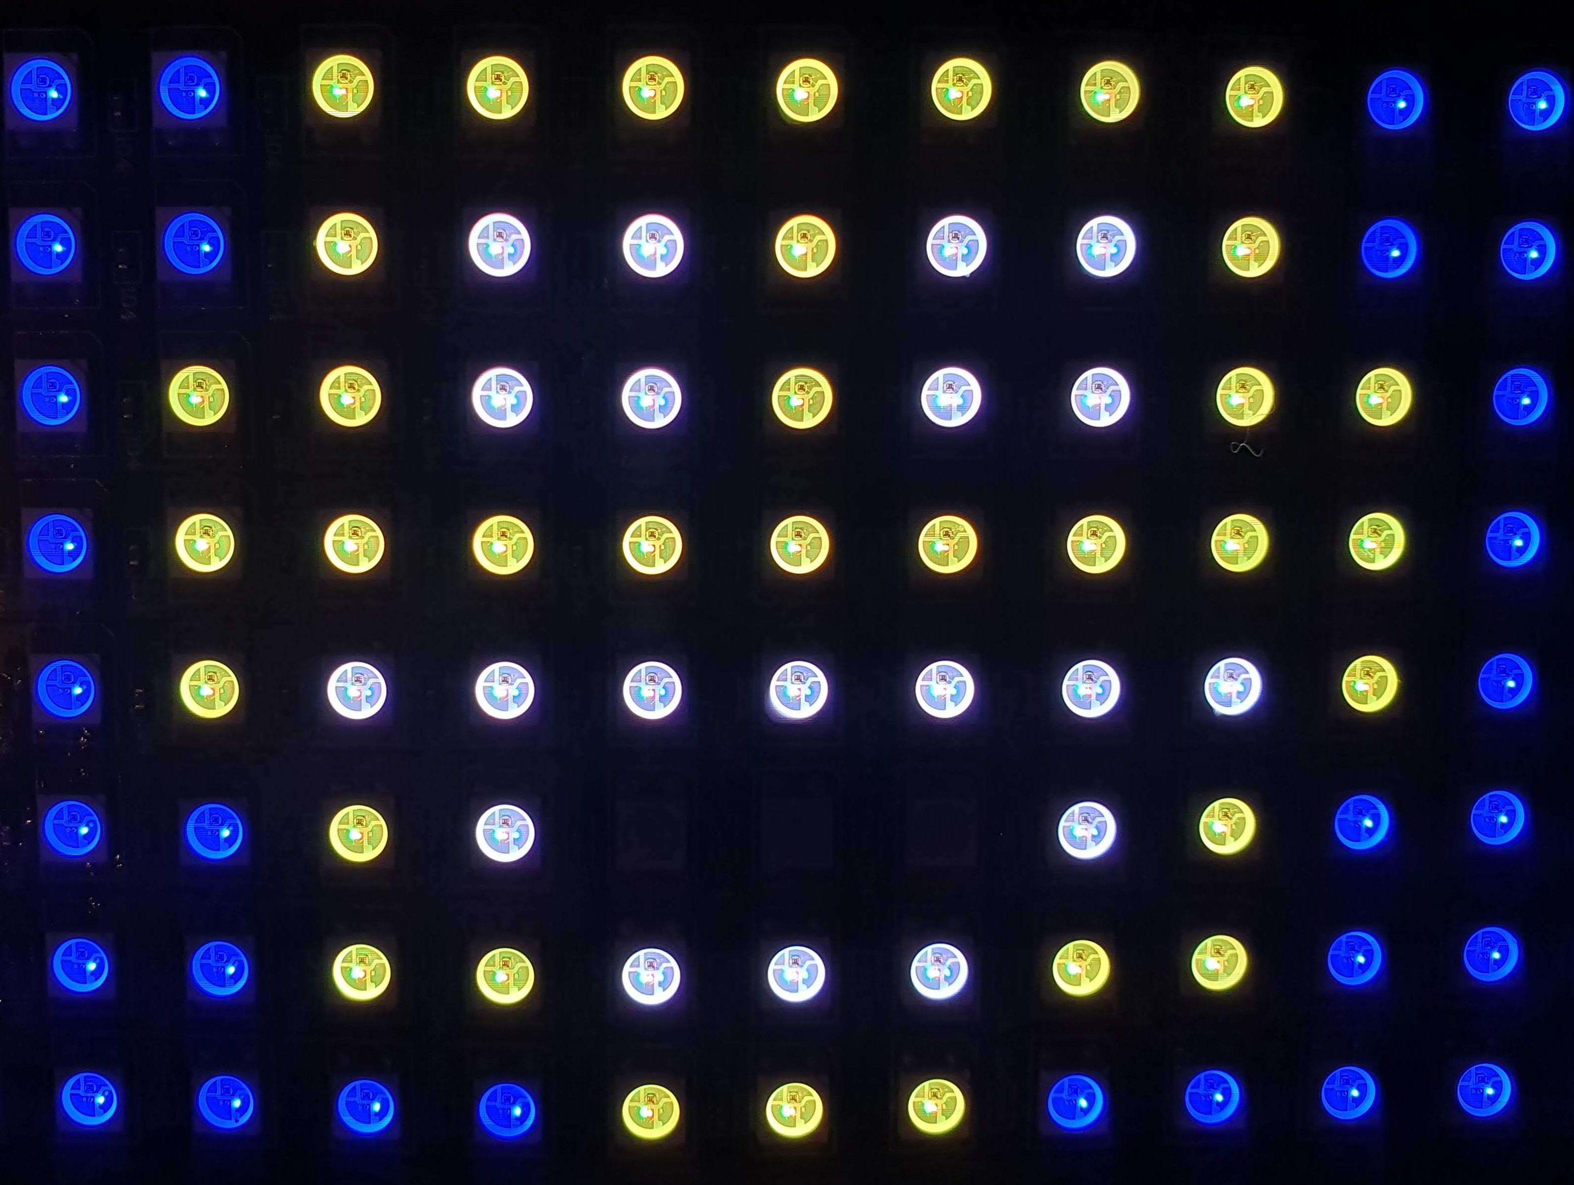
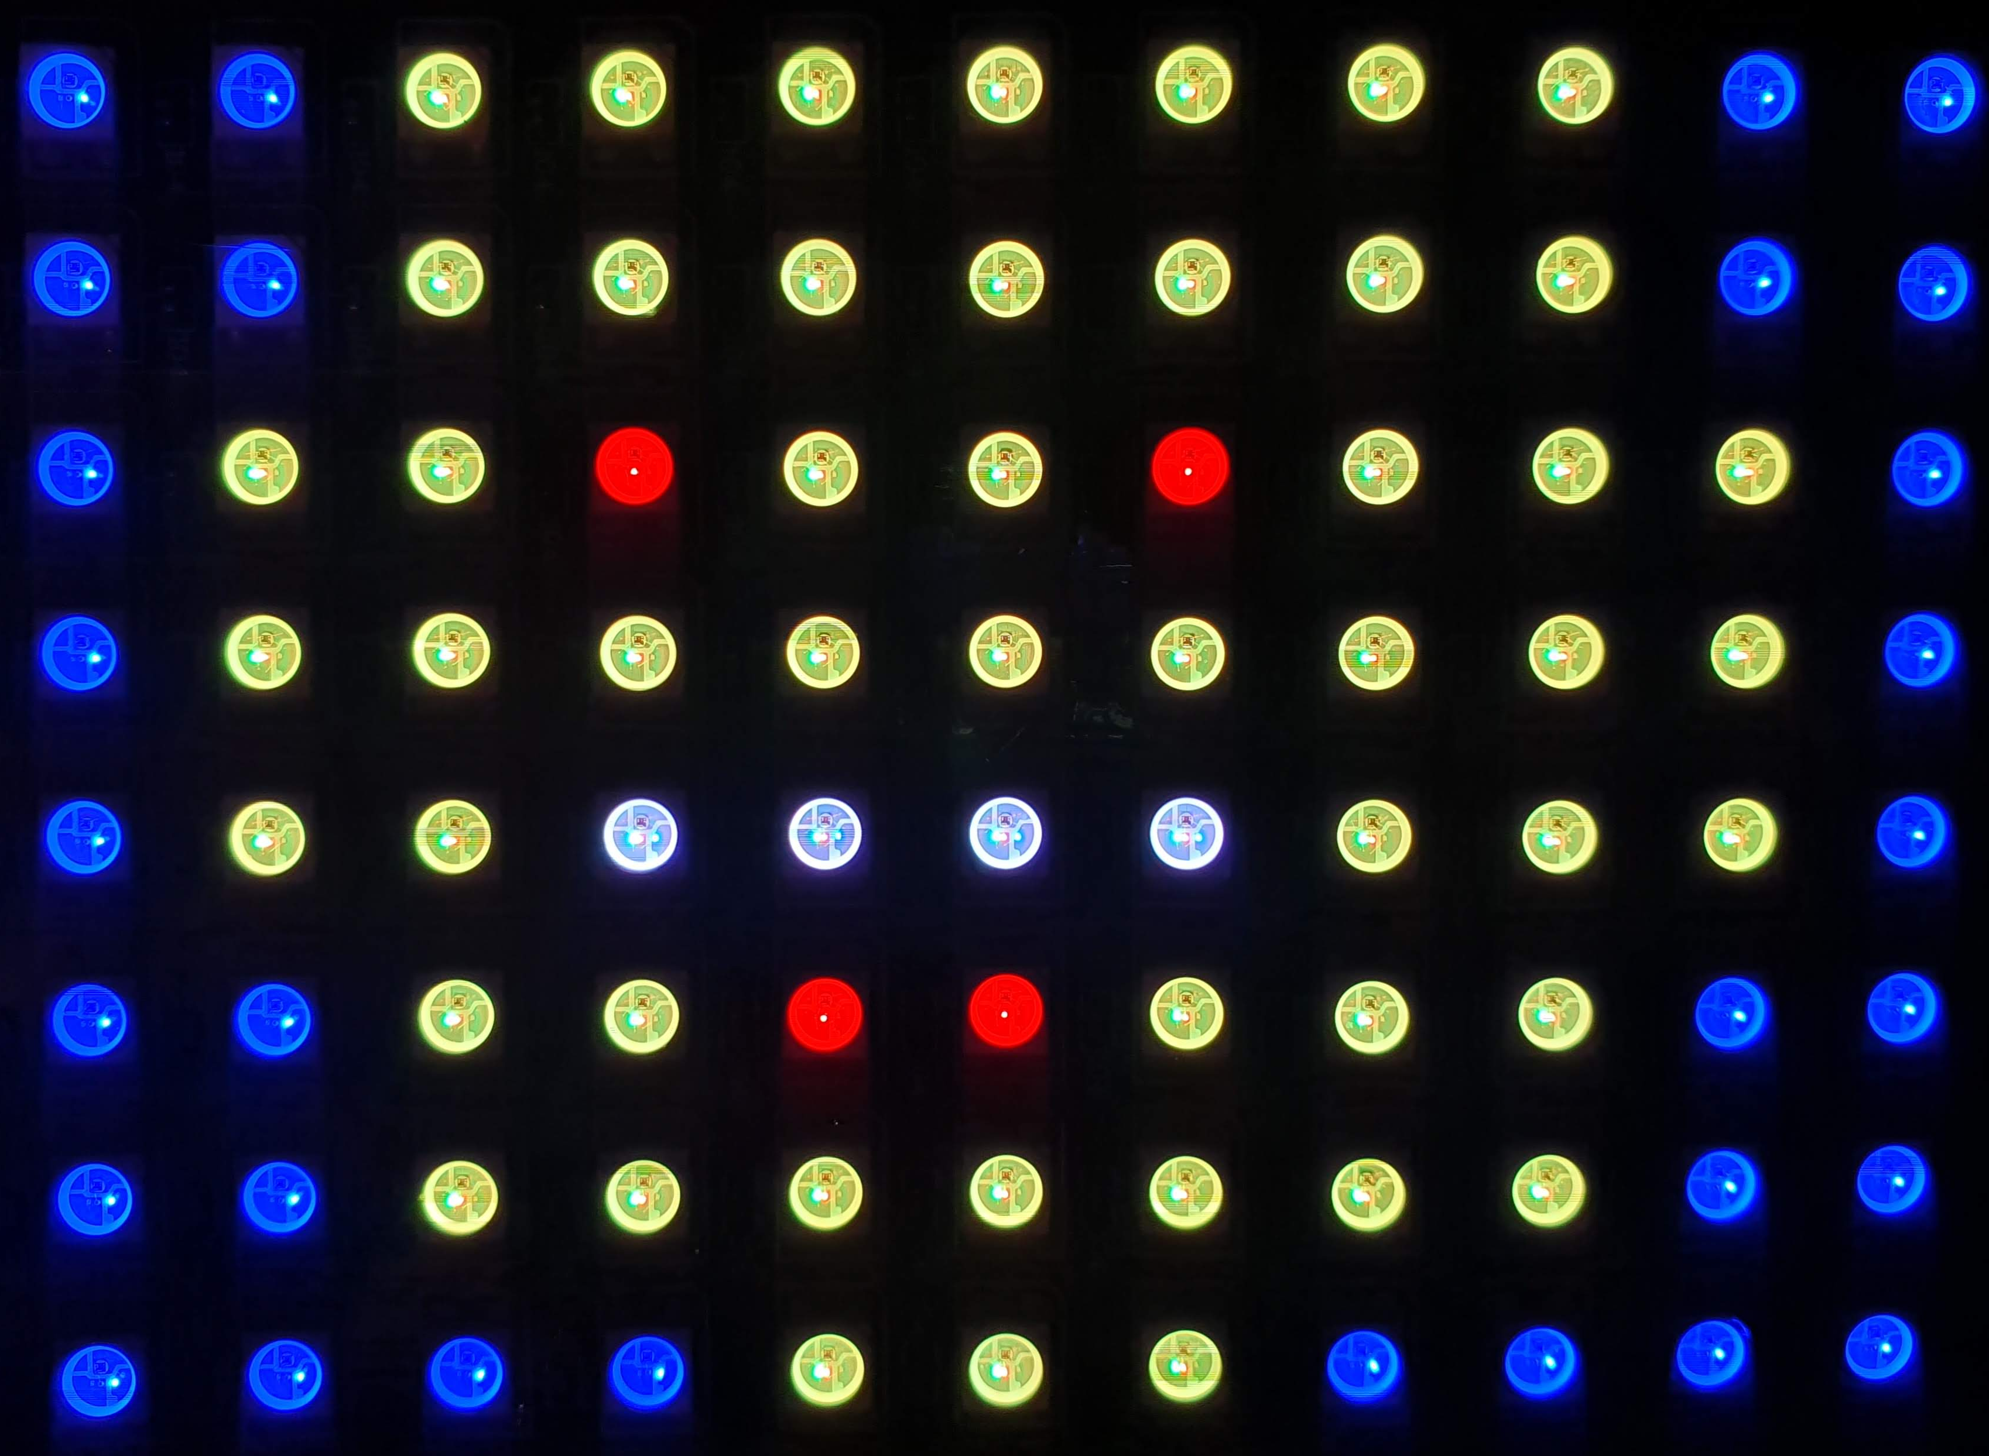
Bronze Challenge 1
Write functions to draw three individual pictures then draw them on the full display. The functions should have x and y parameters to specify where to draw them, e.g. void emojiHappy(int x, int y)
Here are some example attempts at emojis for suggestions. You can draw different pictures if desired

Slide 13
SILVER Challenge:
Drawing a picture and animate it
Taking one or more of the pictures from Bronze challenge 3, animate it to either bounce around the screen or change between a series of frames
If you already have functions from TinkerCad to do this, write functions for alternative movement patterns, e.g. right to left, or disappearing off the bottom and reappearing at the top.
Can you consider rotating the neomatrix so it is taller with falling objects bouncing at the bottom?

Slide 14
GOLD Challenge:
Create a series of animations and effects that combine together the various features covered this topic, e.g.
building up the visualisation of drawing different patterns
rotating between different visual effects
drawing animated pictures

